Slide 1
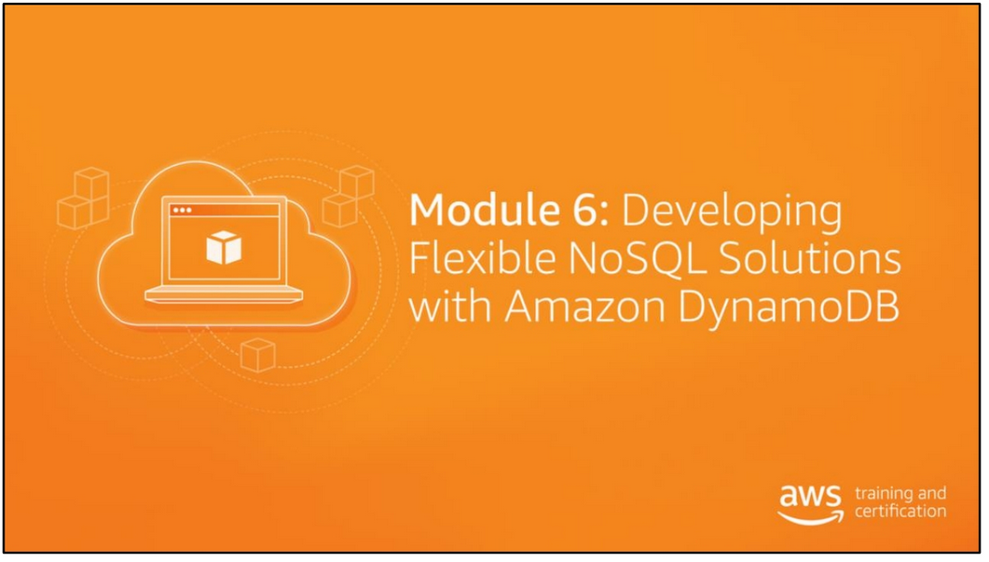

Slide 2
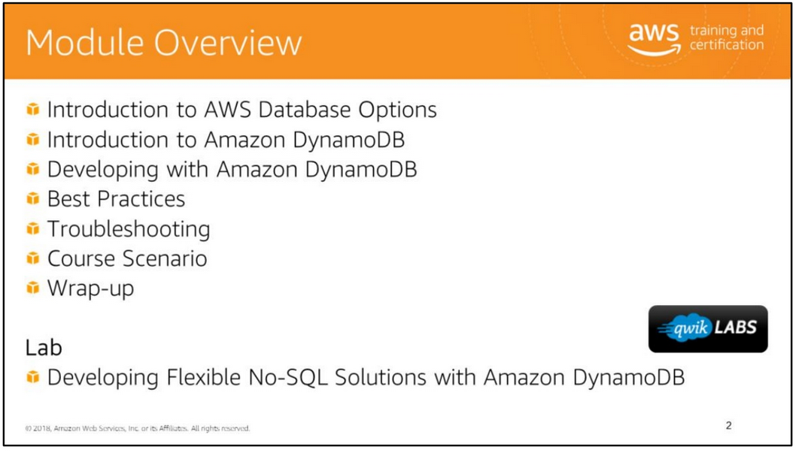

Slide 3
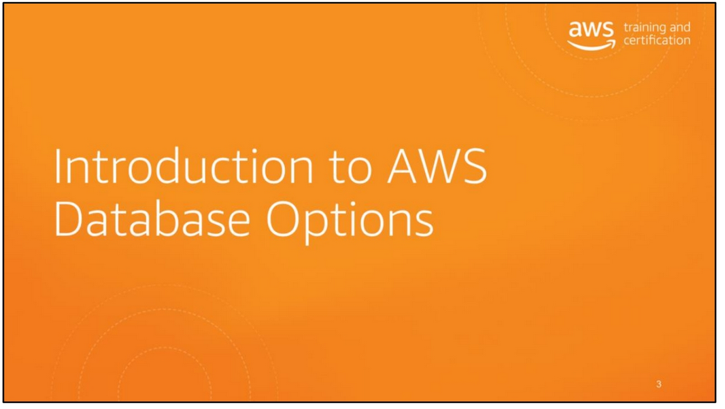

Slide 4
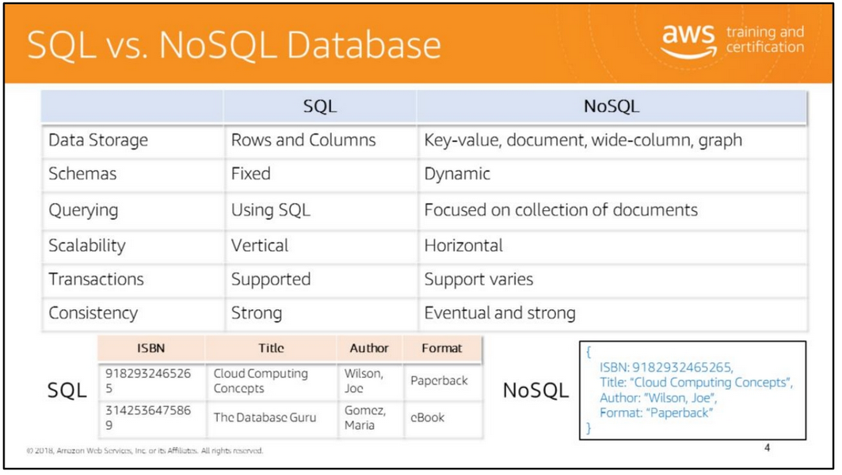
SQL databases have the following characteristics:
• Data is stored in tables that are related to each other through a primary key–foreign key relationship. The database supports complex queries and joins to retrieve a combination of data from various tables.
• The schema of a relational database is defined in the beginning. Changes to the schema usually require a migration of data from the old schema to the new schema.
• Data in SQL databases is queried using SQL (Structured Query Language), which can allow for complex queries.
• Relational databases support vertical scaling which means that a single server must be made more powerful.
• Relational databases support ACID transactions: atomicity, consistency, isolation, and durability.
• Relational databases automatically support strong data consistency due to ACID properties of transactions.
The term NoSQL originally referred to a non-SQL or non-relational database. NoSQL databases have the following characteristics: • NoSQL databases can support wide-column stores, document stores, key-value stores, and graph stores.
The type of data stored varies by NoSQL database.
• NoSQL databases do not have a fixed schema. Different records can have different attributes.
• Data in NoSQL databases is queried by focusing on collections of documents. • NoSQL databases support horizontal scaling. With this approach, you can partition and spread data across multiple cheaper servers instead of purchasing more powerful servers. For example, if a table stores information about 100,000 users, data can be partitioned to store a subset of 10,000 users on each server.
• NoSQL databases generally deliver high performance with eventual consistency. Depending on the database, you can set it to strong consistency if needed for your usage scenario (example of strong consistency: read immediately after a write returns the latest data).

Slide 5
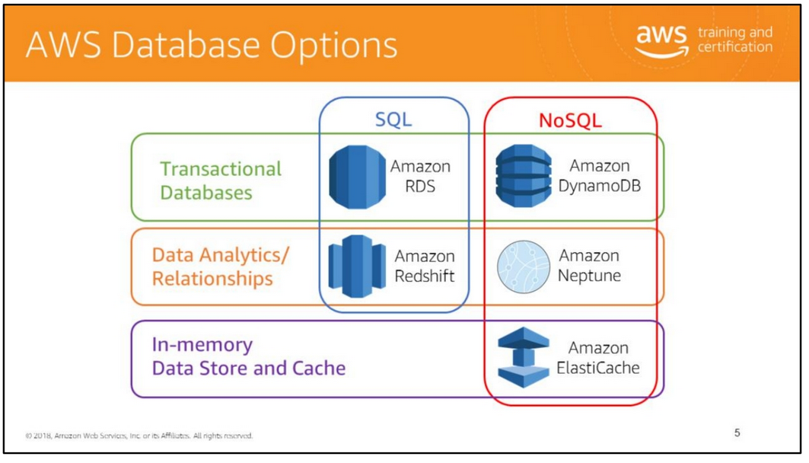
Depending on the application context, type of data, and business needs, you have the following options to store application-related data:
• Amazon Relational Database Service (RDS): Provides relational database services in the cloud with support for the following database engines:
• Amazon Aurora
• PostgreSQL
• MySQL
• MariaDB
• Oracle
• Microsoft SQL Server
• Amazon Redshift: Fast, fully managed data warehouse • Amazon DynamoDB: NoSQL database that supports both document and key-value store models
• Amazon Neptune: Fast, reliable, fully-managed graph database service that makes it easy to build and run applications that work with highly connected datasets
• Amazon ElastiCache: In-memory data cache that supports a fully managed Redis or Memcached engine

Slide 6
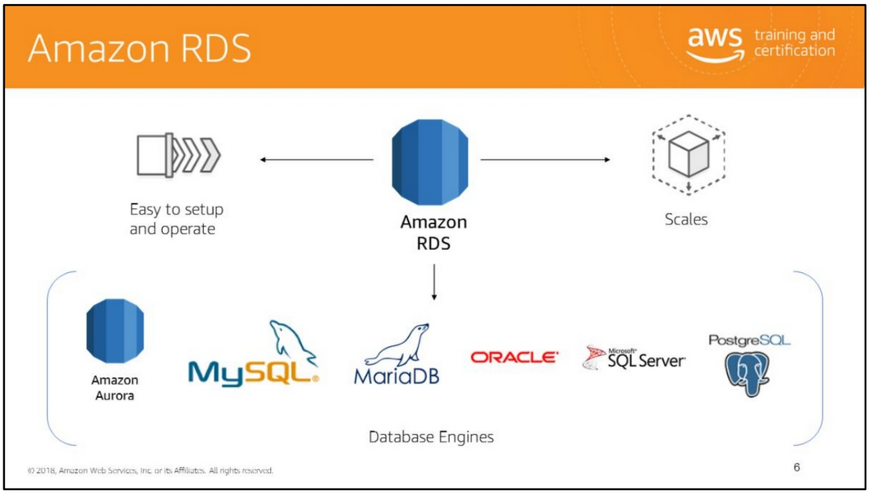
Amazon Relational Database Service (Amazon RDS) makes it easy to set-up, operate, and scale a relational database in the cloud. It provides cost-efficient and resizable capacity while managing time-consuming database administration tasks, freeing you up to focus on your applications and business. For example, Amazon RDS automatically patches the database software and backs up your database.
Amazon RDS provides six familiar database engines to choose from, including Amazon Aurora, Oracle, Microsoft SQL Server, PostgreSQL, MySQL and MariaD

Slide 7
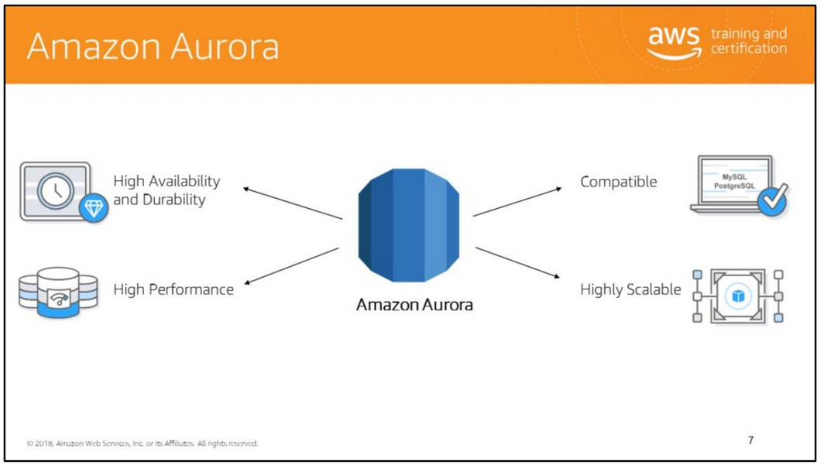
Amazon Aurora is a MySQL and PostgreSQL compatible relational database built for the cloud, that combines the performance and availability of high-end commercial databases with the simplicity and cost-effectiveness of open source databases. Aurora is up to five times faster than the standard MySQL databases all while providing security, availability and reliability of commercial-grade databases at 1/10th of the cost. Aurora is a fully managed database by Amazon Relational Database Service (RDS), which can automate time-consuming tasks such as hardware provisioning, database setups, patching and backups.
Let’s look at some of the benefits of Amazon Aurora. First, it’s fast and available. Amazon Aurora provides five times the throughput of a standard MySQL and three times the throughput of a standard PostgreSQL. You have the ability to easily scale up and down depending on your needs. Amazon Aurora can automatically grow storage as needed as well. Amazon Aurora is also simple to set up and uses SQL queries that you may already use. Another benefit that Amazon Aurora offers is that it is a pay as you go service with no up-front fees. You pay only for the storage and IOs your Amazon Aurora database consumes. Finally it’s a compatible service. It has been designed to be compatible with MySQL and with PostgreSQL, so that your existing applications and tools can run without requiring modification.

Slide 8
Amazon Aurora is a MySQL and PostgreSQL compatible relational database built for the cloud, that combines the performance and availability of high-end commercial databases with the simplicity and cost-effectiveness of open source databases. Aurora is up to five times faster than the standard MySQL databases all while providing security, availability and reliability of commercial-grade databases at 1/10th of the cost. Aurora is a fully managed database by Amazon Relational Database Service (RDS), which can automate time-consuming tasks such as hardware provisioning, database setups, patching and backups.
Let’s look at some of the benefits of Amazon Aurora. First, it’s fast and available. Amazon Aurora provides five times the throughput of a standard MySQL and three times the throughput of a standard PostgreSQL. You have the ability to easily scale up and down depending on your needs. Amazon Aurora can automatically grow storage as needed as well. Amazon Aurora is also simple to set up and uses SQL queries that you may already use. Another benefit that Amazon Aurora offers is that it is a pay as you go service with no up-front fees. You pay only for the storage and IOs your Amazon Aurora database consumes. Finally it’s a compatible service. It has been designed to be compatible with MySQL and with PostgreSQL, so that your existing applications and tools can run without requiring modification.

Slide 9
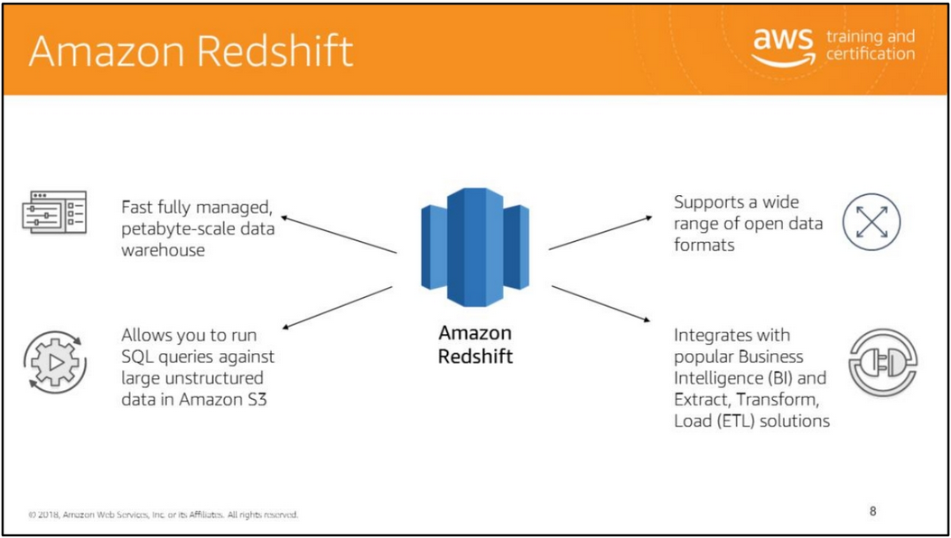
Amazon Redshift is a fast, fully managed, petabyte-scale data warehouse that makes it simple and cost-effective to analyze all your data using your existing business intelligence (BI) tools. You can start small with no commitments and scale to petabytes typically for less than a tenth the cost of traditional solutions.
Amazon Redshift provides custom JDBC and ODBC drivers to enable you to use familiar SQL client tools. It uses a variety of innovations to obtain very high query performance on datasets ranging in size from hundreds of gigabytes to a petabyte or more. First, it uses columnar storage and data compression to reduce the amount of I/O needed to perform queries. Second, it runs on hardware that is optimized for data warehousing, with local attached storage and 10-GB network connections between nodes. Finally, it has a massively parallel processing (MPP) architecture, which enables you to scale up or down, without downtime, as your performance and storage needs change.
Amazon Redshift also includes Redshift Spectrum, allowing you to directly run SQL queries against exabytes of unstructured data in Amazon S3. No loading or transformation is required, and you can use open data formats, including Avro, CSV, Grok, Ion, JSON, ORC, Parquet, RCFile, RegexSerDe, SequenceFile, TextFile, and TSV.
Redshift Spectrum automatically scales query compute capacity based on the data being retrieved, so queries against Amazon S3 run fast, regardless of data set size.

Slide 10
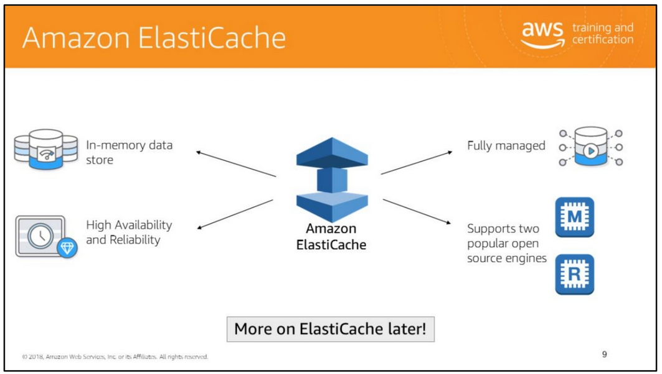
Amazon ElastiCache makes it easy to deploy, operate, and scale an in-memory data store or cache in the cloud. The service improves the performance of web applications by allowing you to retrieve information from fast, managed, in-memory caches, instead of relying entirely on slower disk-based databases. Amazon ElastiCache provides the choice of two fully managed in-memory Key-Value stores in the cloud:
• ElastiCache for Redis: Redis is a fast, open source, in-memory key-value data store for use as a database, cache, message broker, and queue. It delivers sub-millisecond response times enabling millions of requests per second for real-time applications in Gaming, Ad-Tech, Financial Services, Healthcare, and IoT. Redis is a popular choice for caching, session management, real-time analytics, geospatial, chat/messaging, media streaming, and gaming leaderboards.
• ElastiCache for Memcached: Memcached-compatible in-memory key-value store service that can be used as a cache or a data store. It delivers the performance, ease-of-use, and simplicity of Memcached. ElastiCache for Memcached is fully managed, scalable, and secure, making it an ideal candidate for use cases where frequently accessed data must be in-memory. It is a popular choice for use cases such as Web, Mobile Apps, Gaming, Ad-Tech, and E-Commerce.

Slide 11
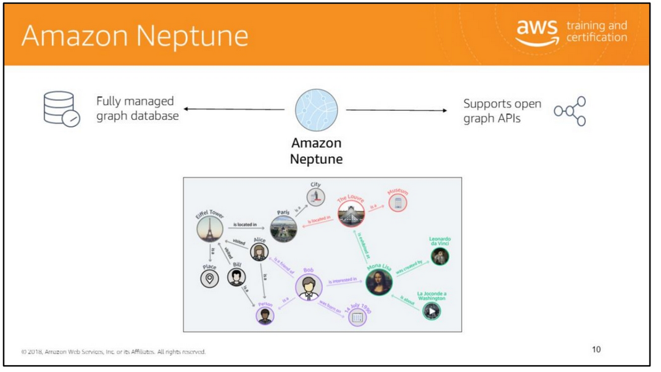
Amazon Neptune is a fast, reliable, fully-managed graph database service that makes it easy to build and run applications that work with highly connected datasets. The core of Amazon Neptune is a purpose-built, high-performance graph database engine optimized for storing billions of relationships and querying the graph with milliseconds latency.
A graph database is ideal when you need to create relationships between data and quickly query these relationships. This type of requirement is challenging to satisfy using a relational database because you would need multiple tables with multiple foreign keys. In addition, SQL queries to navigate this data would require nested queries and complex joins that could quickly become complex and inefficient as your data size grows over time. Neptune uses graph structures such as nodes (data entities), edges (relationships), and properties to represent and store data. The relationships are stored as first order citizens of the data model. This allows data in nodes to be directly linked, dramatically improving the performance of queries that navigate relationships in the data.
Amazon Neptune supports popular graph models Apache TinkerPop and W3C's Resource Description Framework (RDF), and their associated query languge
TinkerPop Gremlin, and Simple Protocol and RDF Query Language (SPARQL). This allows you to easily build queries that efficiently navigate highly connected datasets. Neptune powers graph use cases such as recommendation engines, fraud detection, knowledge graphs, drug discovery, and network security.

Slide 12
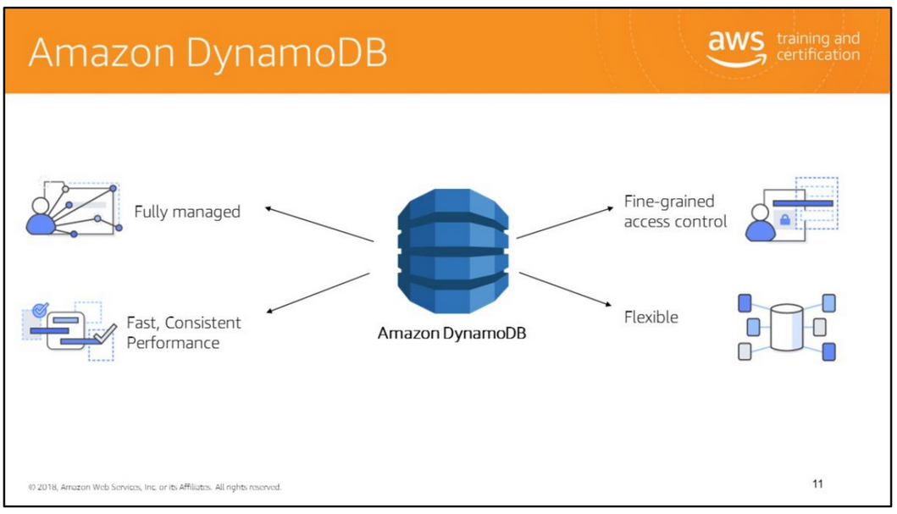
Amazon DynamoDB is a fast and flexible non-relational database service for all applications that need consistent, single-digit millisecond latency at any scale. It is a fully managed cloud database and supports both document and key-value store models.
Fully managed DynamoDB is a fully managed, nonrelational database service—you simply create a database table, set your target utilization for auto scaling, and let the service handle the rest. You no longer need to worry about database management tasks such as hardware or software provisioning, setup and configuration, software patching, operating a distributed database cluster, or partitioning data over multiple instances as you scale. DynamoDB also provides point-in-time recovery, backup, and restore for all your tables, helping you meet your corporate and regulatory archival requirements.
Low-latency queries Average service-side latencies are typically single-digit milliseconds. As your data volumes grow and application performance demands increase, DynamoDB uses automatic partitioning and SSD technologies to meet your throughput requirements and deliver low latencies at any scale.

Slide 13
Fine-grained access control
DynamoDB integrates with AWS Identity and Access Management (IAM) for fine-grained access control of users in your organization. You can assign unique security credentials to each user and control each user's access to services and resources.
Flexible
DynamoDB supports storing, querying, and updating documents. By using the AWS SDK you can write applications that store JSON documents directly into Amazon DynamoDB tables. This capability reduces the amount of new code to be written to insert, update, and retrieve JSON documents, and perform powerful database operations such as nested JSON queries by using just a few lines of code.

Slide 14
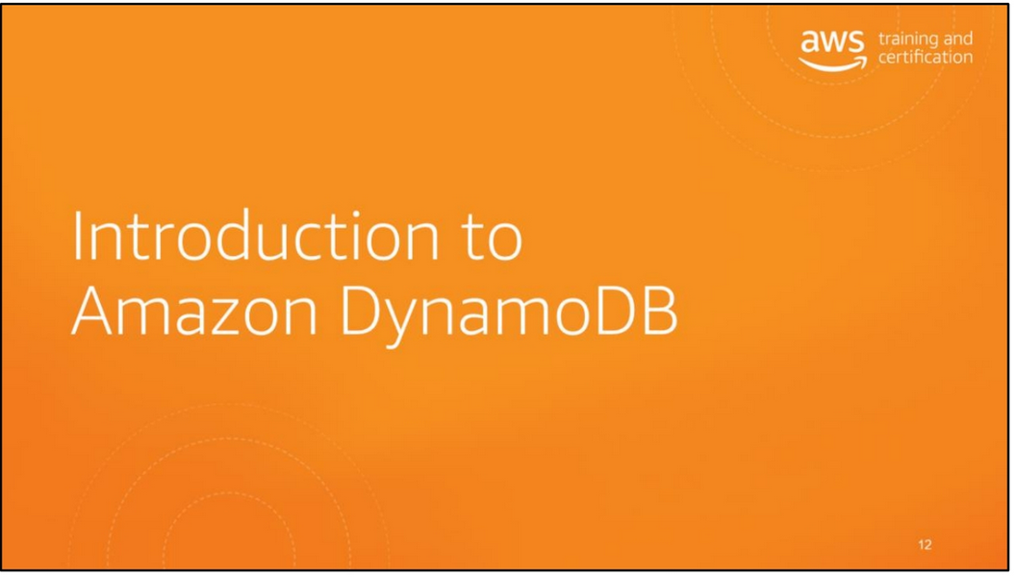

Slide 15
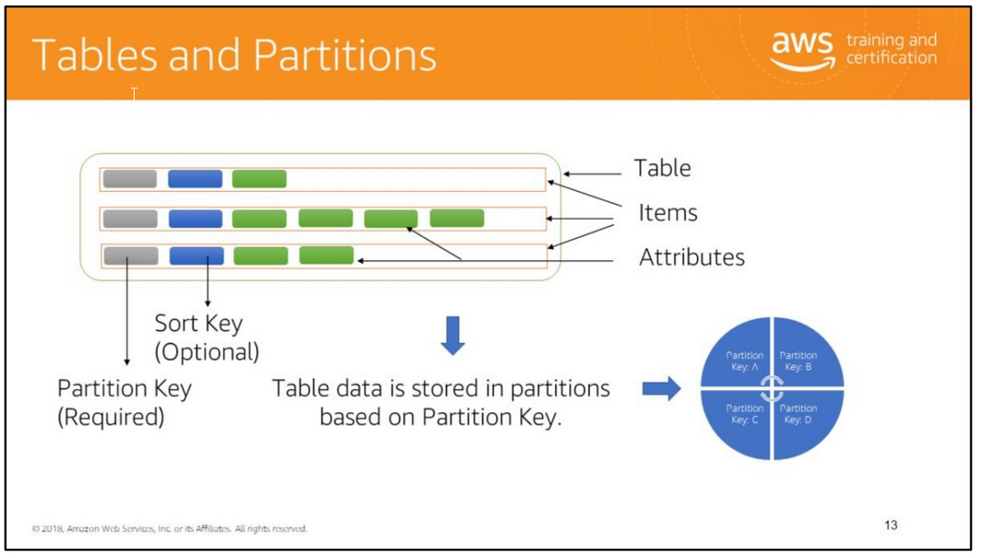
In Amazon DynamoDB, data is stored in tables. A table contains items with attributes. You can think of items as rows or tuples in a relational database, and attributes as columns.
DynamoDB stores data in partitions and divides a table's items into multiple partitions based on the partition key value. A partition is an allocation of storage for a table, backed by solid-state drives (SSDs) and automatically replicated across multiple Availability Zones within an AWS Region. Partition management is handled entirely by DynamoDB. The partition key of an item is also known as its hash attribute.
A sort key can be defined to store all of the items with the same partition key value physically close together and order them by sort key value in the partition. It represents a one-to-many relationship based on the partition key and enables querying on the sort key attribute. The sort key of an item is also known as its range attribute.
For information about the DynamoDB data model, see https://docs.aws.amazon.com/amazondynamodb/latest/developerguide/HowItWork s.Partitions.html .
For information about working with tables, see http://docs.aws.amazon.com/amazondynamodb/latest/developerguide/WorkingWit hTables.html .

Slide 16
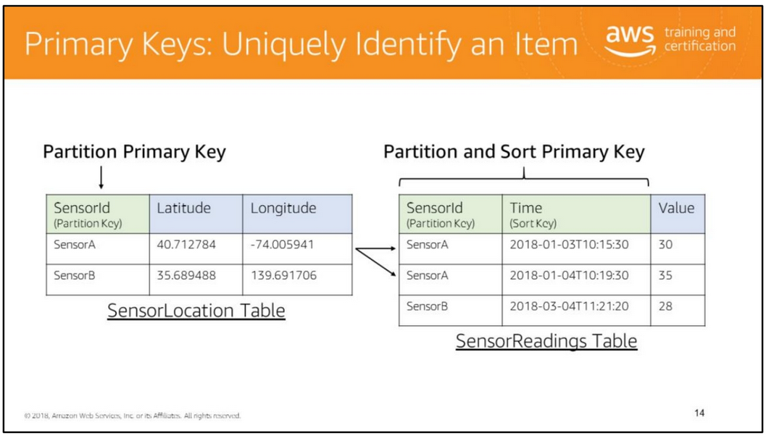
A table has a primary key that uniquely identifies each item in the table. There are two types of primary keys:
• Partition primary key: The primary key consists of a single attribute, the partition key. DynamoDB builds an unordered index on this primary key attribute. Each item in the table is uniquely identified by its partition key value.
• Partition and sort primary key: The primary key is made of two attributes. The first attribute is the partition key attribute and the second attribute is the sort key attribute. DynamoDB builds an unordered index on the partition key attribute and a sorted index on the sort key attribute. Each item in the table is uniquely identified by the combination of its partition key and sort key values.
In the SensorLocation table example above, the primary key is a partition primary key because it consists the single SensorId attribute which is the partition key. In other words, each item in the table is uniquely identified by its partition key value. Also, each sensor has exactly one location, which is expressed in terms of latitude and longitude.
In the SensorReadings table, the primary key is composed of a partition key and a sort key. The SensorId attribute is the partition key and Time attribute is the sort key.
It is, therefore, a partition and sort primary key. For each SensorId, there may be multiple items corresponding to sensor readings at different times. The combination of SensorId and Time uniquely identifies items in the table. This design enables you to query the table for all readings related to a particular sensor.
Remember that DynamoDB can be used as a key-value store and document store. In the examples shown, the primary key value (partition key and sort key if present) is the key and the remaining attributes constitute the value corresponding to the key.

Slide 17
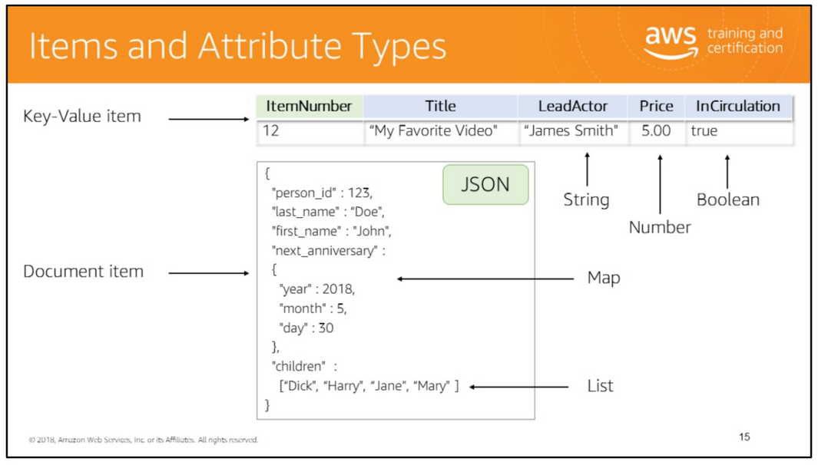
An item is a collection of attributes. Items are analogous to rows and attributes are analogous to columns in a relational database table.
Each attribute has a name, data type, and value. An item can have any number of attributes. Unlike a relational database, DynamoDB is not constrained by a pre-defined schema. Items in a table can have different types of attributes.
Attributes can have one of the following data types:
• Scalar types: Number, String, Binary, Boolean, and Null
• Multi-valued types: String Set, Number Set, and Binary Set
• Document types: List and Map
You can store a JSON-formatted document as an item in DynamoDB.
The size of an item is the sum of the lengths of its attribute names and values. An item can be a maximum of 400KB in size.
For information about the DynamoDB data model, see https://docs.aws.amazon.com/amazondynamodb/latest/developerguide/HowItWork s.Partitions.html .

Slide 18
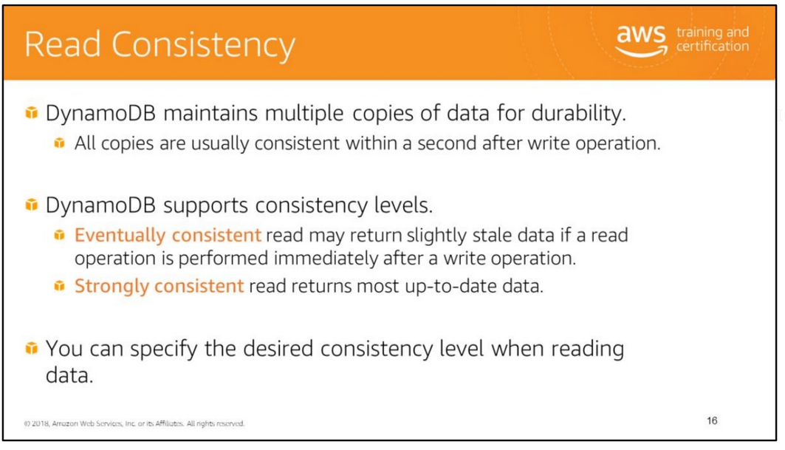
When querying data, you can specify whether DynamoDB should return strongly consistent data.
For more information, see https://docs.aws.amazon.com/amazondynamodb/latest/developerguide/HowItWork s.ReadConsistency.html .

Slide 19
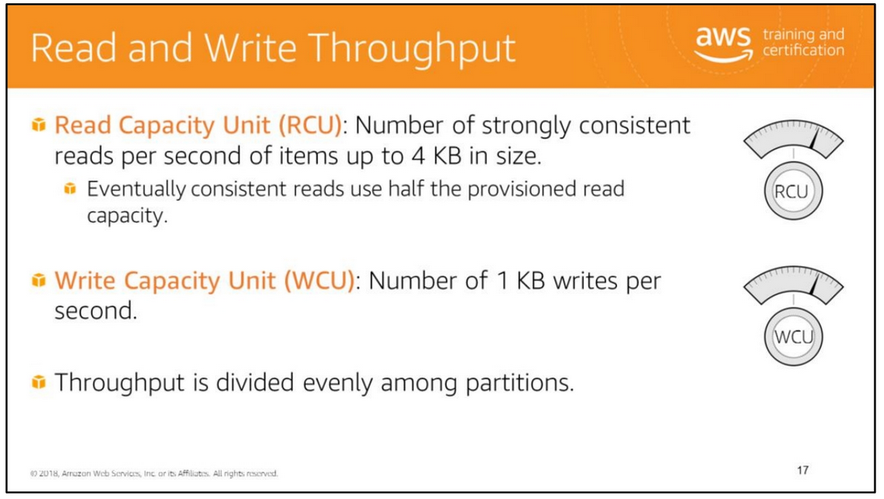
To ensure high throughput and low latency responses, DynamoDB requires that you specify read and write throughput values when you create a table. This ensures predictable, low-latency response times. DynamoDB reserves the necessary resources to handle your throughput requirements. If you expect spikes in your workload, you can set higher throughput values by updating the table.
Throughput is specified in terms of read capacity units (RCU) and write capacity units (WCU). A read capacity unit is the number of strongly consistent reads per second of items up to 4 KB in size. If you perform eventually consistent reads, you use half the read capacity units provisioned. In other words, for eventually consistent reads, one read capacity unit is two reads per second for items up to 4 KB. A write capacity unit is the number of 1 KB writes per second.
Read and write capacity unit values can be set independent of each of other. For example, you might increase only the read capacity units if you expect a spike in reads from the table. DynamoDB will return an error if the provisioned throughput has been exceeded (ProvisionedThroughputExceeded exception).
DynamoDB divides the throughput evenly among partitions. Throughput per partition is the total provisioned throughput divided by the number of partitions.
Set your required throughput value by setting the ProvisionedThroughput parameter when you create or update a table.
For information about how to calculate provisioned throughput values based on the item size and required reads and writes per second, see http://docs.aws.amazon.com/amazondynamodb/latest/developerguide/WorkingWithTables.html.

Slide 20
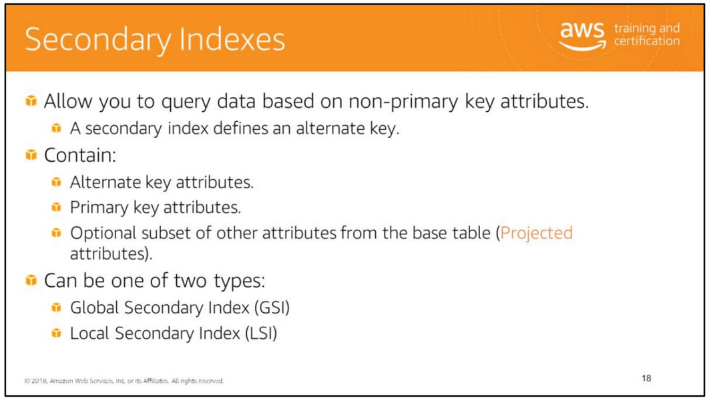
If you want to perform queries on attributes that are not part of the table’s primary key, you can create a secondary index. A secondary index lets you query the data in the table using an alternate key, in addition to queries against the primary key.
In addition to the alternate key attributes (partition key and sort key), a secondary index contains a subset of the other table attributes. When you create an index, you specify which attributes will be copied, or projected, from the base table to the index. At a minimum, DynamoDB projects the key attributes from the base table into the index.
There are two types of secondary indexes: global secondary index and local secondary index. You can define up to 5 global secondary indexes and 5 local secondary indexes per table.
DynamoDB automatically creates indexes based on the primary key of a table and automatically updates all indexes whenever a table changes

Slide 21
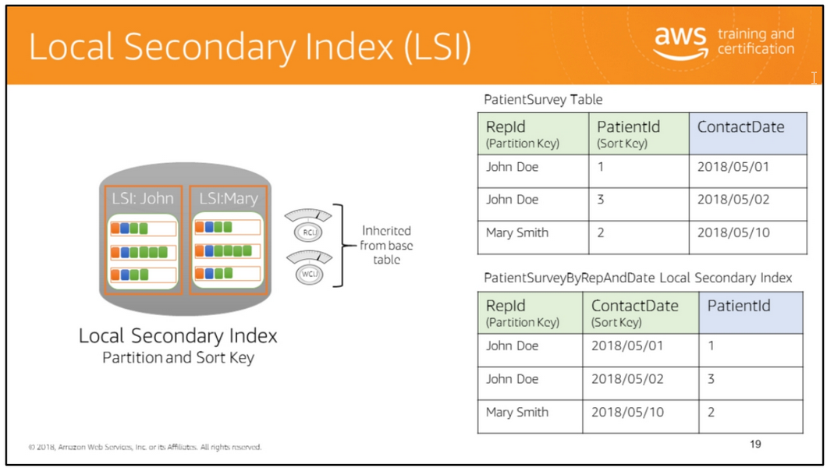
A local secondary index is considered to be local because the index is located on the same table partition as the items that have a particular partition key. You can only query over data in a single partition as specified by the partition key value in the query.
The characteristics of a local secondary index are:
• The partition key is the same as the table’s partition key. The sort key can be any scalar attribute.
• It can only be created when a table is created.
• It cannot be deleted.
• It supports eventual consistency and strong consistency.
• It does not have its own provisioned throughput. Instead, it uses the table’s read and write capacity units.
• Queries can return attributes that are not projected into the index.
• All the items with a particular partition key in the table and the items in the corresponding local secondary index (together known as an item collection) are stored
Consider the example of the PatientSurvey table. The table stores information about the customer representative (RepId) who conducted the survey, the ID of the patient surveyed (PatientId), and the contact date (ContactDate). RepId is the partition key and PatientId is the sort key. This design enables you to query all patients contacted by a particular customer representative.
To query all dates on which each representative contacted a patient, you can set up a local secondary index with RepId as the partition key and ContactDate as the sort key. Note that the local secondary index has the same partition key as the table and a different sort key. Because the index is located on the table’s partition, it shares the table’s provisioned throughput.

Slide 22
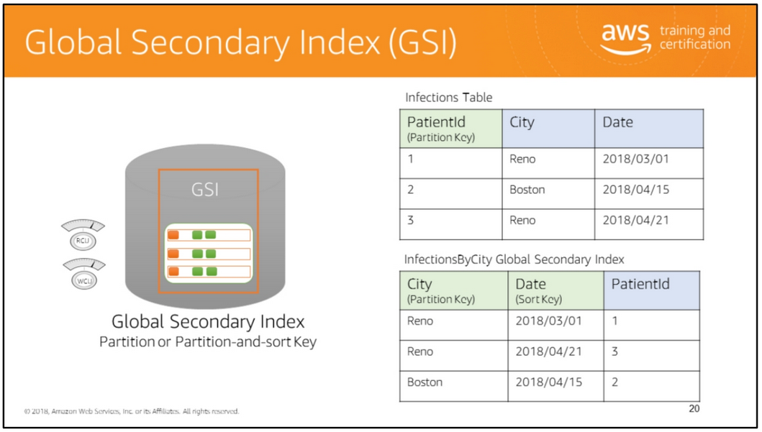
A global secondary index is considered to be global because queries on this index can span all the data in a table, across all partitions. The characteristics of a global secondary index are:
• It can have a partition key and optional sort key that are different from the partition key and sort key of the original table.
• Key values do not need to be unique.
• It can be created when a table is created or can be added to an existing table.
• It can be deleted.
• It supports eventual consistency only.
• It has its own provisioned throughput settings for read and write operations.
• Queries only return attributes that are projected into the index.
Consider the example of the Infections table that is used to track the infections reported in cities. For each patient, the Infections table contains a PatientId, City, and Date that the infection was reported. The PatientId attribute is the partition key. There is no sort key. This design enables you to query information by PatientId.

Slide 23
Now consider the situation where the country’s health department wants to query the data to gather statistics about infections reported by city and date. Such a query is not possible with the Infections table. To support this query, you need to create a secondary index with City as the partition key and Date as the sort key. Note that the combination of City and Date may not be unique. Many patients may report an infection in a city on the same day. A global secondary index is ideally suited for this scenario because in a global secondary index the combination of primary key attributes does not need to be unique.
If eventual consistency is suitable for your application, we recommend that you use global secondary indexes.
For more information, see http://docs.aws.amazon.com/amazondynamodb/latest/developerguide/SecondaryIn dexes.html .

Slide 24
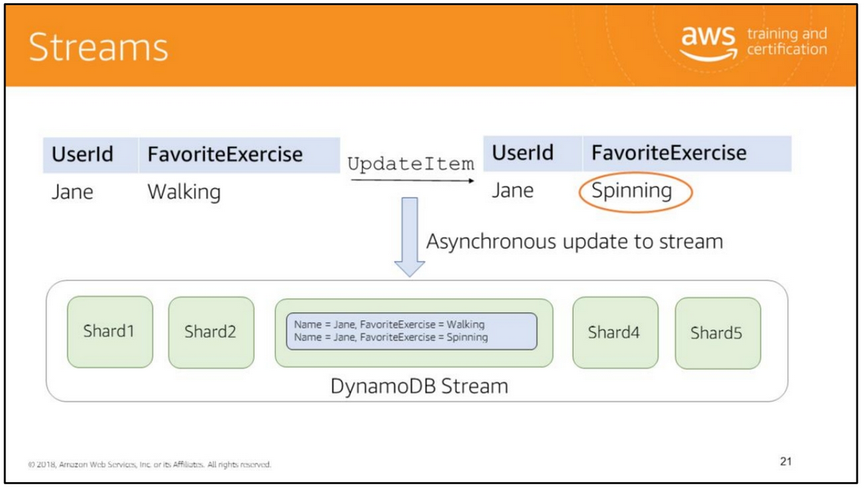
A DynamoDB stream is an ordered flow of information about changes to a table. A stream contains changes to items in a single table.
When you make an update to a table, DynamoDB first persists the data durably to the table. It then asynchronously updates the corresponding stream with information about the changes made. The asynchronous update is made to the stream with sub-second latency. The update to the stream does not affect the write throughput of the table.
The records in the stream are strictly in the order in which the changes occurred. Each change contains exactly one stream record. A stream record is available for 24 hours.
Streams scale by splitting data across shards.
Consider an example where an application makes changes to user preferences that are stored in a DynamoDB table. Another application such as an ad server needs to respond to changes in user preferences and present different advertisements. The ad server application can read information about changes from the DynamoDB stream and present advertisements corresponding to the new preferences.

Slide 25

A DynamoDB stream is an ordered flow of information about changes to a table. A stream contains changes to items in a single table.
When you make an update to a table, DynamoDB first persists the data durably to the table. It then asynchronously updates the corresponding stream with information about the changes made. The asynchronous update is made to the stream with sub-second latency. The update to the stream does not affect the write throughput of the table.
The records in the stream are strictly in the order in which the changes occurred. Each change contains exactly one stream record. A stream record is available for 24 hours.
Streams scale by splitting data across shards.
Consider an example where an application makes changes to user preferences that are stored in a DynamoDB table. Another application such as an ad server needs to respond to changes in user preferences and present different advertisements. The ad server application can read information about changes from the DynamoDB stream and present advertisements corresponding to the new preferences.

Slide 26
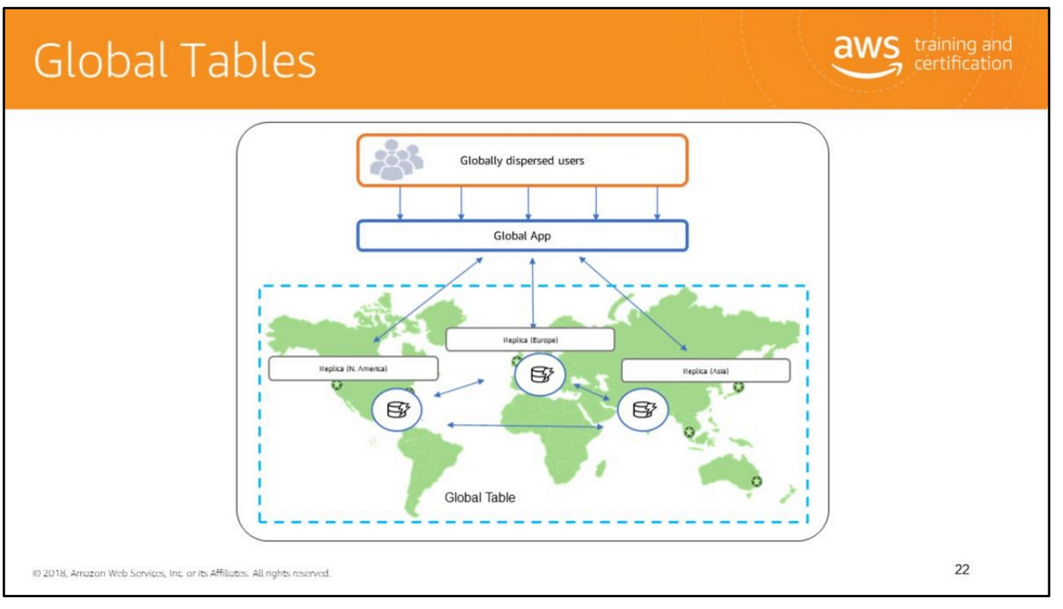
A global table is a collection of one or more DynamoDB tables, all owned by a single AWS account, identified as replica tables. A replica table (or replica, for short) is a single DynamoDB table that functions as a part of a global table. Each replica stores the same set of data items. Any given global table can only have one replica table per region, and every replica has the same table name and the same primary key schema.
Amazon DynamoDB global tables provide a fully managed solution for deploying a multi-region, multi-master database, without having to build and maintain your own replication solution. When you create a global table, you specify the AWS regions where you want the table to be available. DynamoDB performs all of the necessary tasks to create identical tables in these regions, and propagate ongoing data changes to all of them.

Slide 27
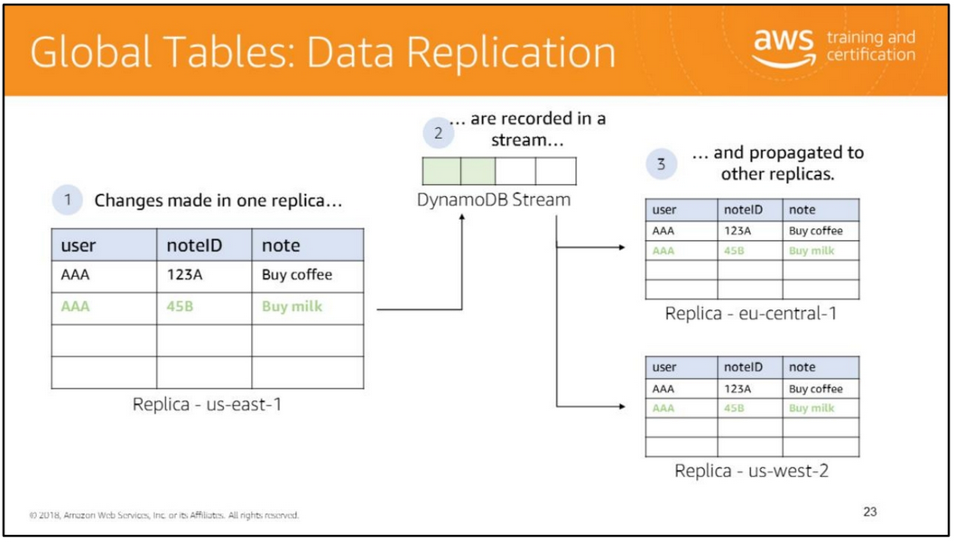
Any changes made to any item in any replica table will be replicated to all of the other replicas within the same global table. In a global table, a newly written item, such as the one you see on this slide, is usually propagated to all replica tables within seconds. With a global table, each replica table stores the same set of data items. DynamoDB does not support partial replication of only some of the items.

Slide 28
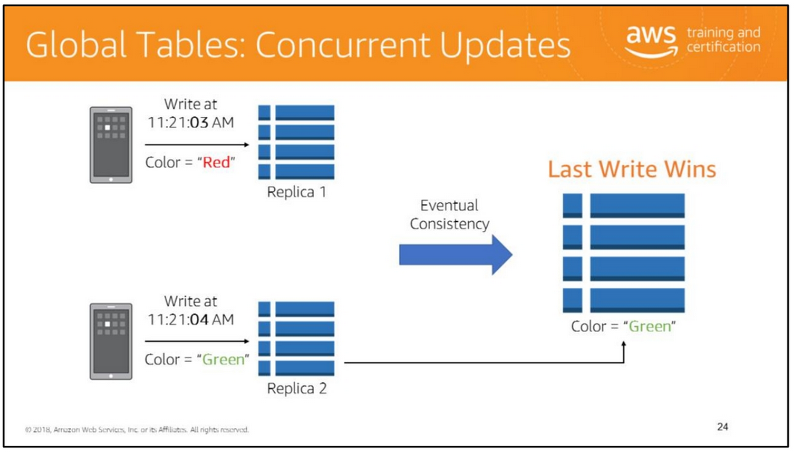
Conflicts can arise if applications update the same item in different regions at about the same time. To ensure eventual consistency, DynamoDB global tables use a “last writer wins” reconciliation between concurrent updates, where DynamoDB makes a best effort to determine the last writer. With this conflict resolution mechanism, all of the replicas will agree on the latest update, and converge toward a state in which they all have identical data.

Slide 29
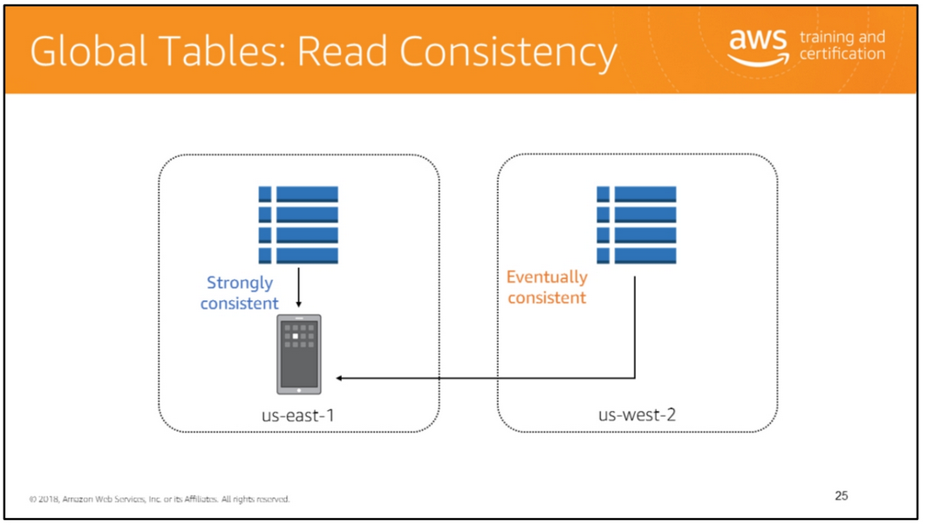
Strongly consistent reads require using a replica in the same region as where the client is running.
An application can read and write data to any replica table. If your application only uses eventually consistent reads, and only issues reads against one AWS region, then it will work without any modification. However, if your application requires strongly consistent reads, then it must perform all of its strongly consistent reads and writes in the same region. DynamoDB does not support strongly consistent reads across AWS regions; therefore, if you write to one region and read from another region, the read response might include stale data that doesn't reflect the results of recently-completed writes in the other region.

Slide 30
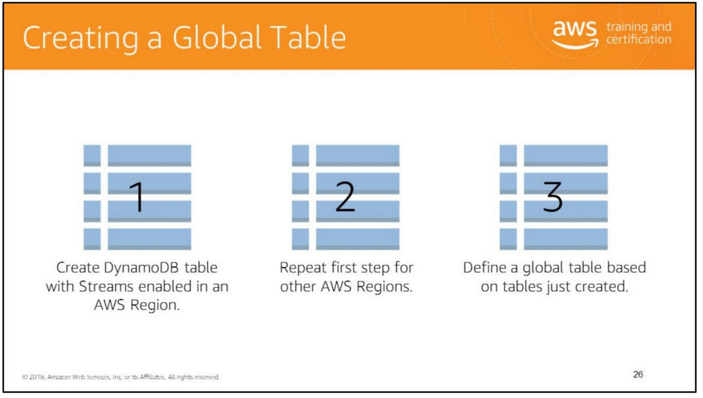
DynamoDB global tables can be created in three steps: 1. Create an ordinary DynamoDB table, with DynamoDB Streams enabled, in an AWS Region.
2. Repeat step 1 for every other AWS Region where you want to replicate your data. 3. Define a DynamoDB global table based on the tables that you have created.
The AWS Management Console automates these tasks, so you can create a global table quickly and easily

Slide 31
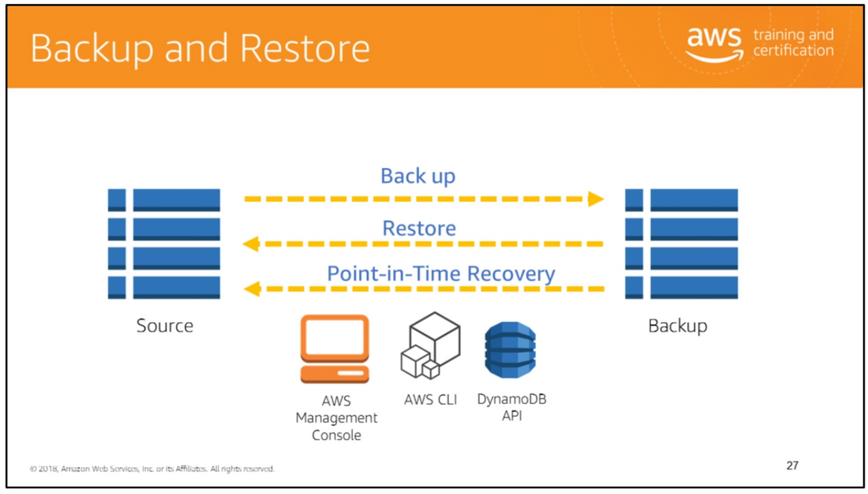
Amazon DynamoDB provides on-demand backup and restore capabilities. It allows you to create full backups of your tables for long-term retention and archival for regulatory compliance needs. You can back up and restore your DynamoDB table data any time with a single click in the AWS Management Console or with a single API call. Backup and restore actions execute with zero impact on table performance or availability.
When you create an on-demand backup, a time marker of the request is cataloged. The backup is created asynchronously by applying all changes until the time of the request to the last full table snapshot. Backup requests are processed instantaneously and become available for restore within minutes.
Each time you create an on-demand backup, the entire table data is backed up. There is no limit to the number of on-demand backups that can be taken. All backups in DynamoDB work without consuming any provisioned throughput on the table.
Point-in-time recovery
Point-in-time recovery helps protect your Amazon DynamoDB tables from accidental write or delete operations. With point in time recovery, you don't have to worry about creating, maintaining, or scheduling on-demand backups. For example, suppose that a test script writes accidentally to a production DynamoDB table. With point-in-time recovery, you can restore that table to any point in time during the last 35 days. DynamoDB maintains incremental backups of your table.

Slide 32
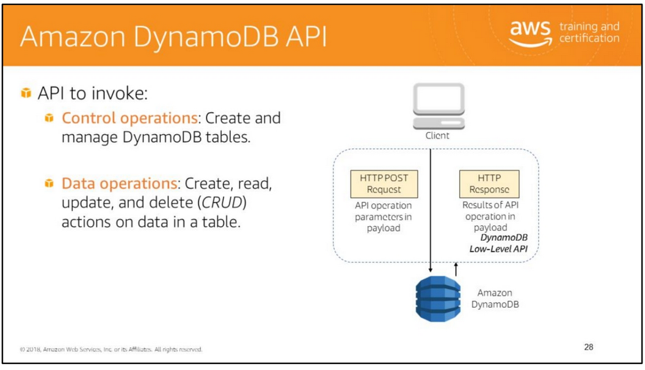
The Amazon DynamoDB API allows you to invoke the following types of operations from an application:
• Control operations: Let you create and manage DynamoDB tables. They also let you work with indexes, streams, and other objects that are dependent on tables.
• Data operations: Let you perform CRUD actions on data in a table. Some of the data operations also let you read data from a secondary index.
• Stream operations: Let you enable or disable a stream on a table, and allow access to the data modification records contained in a stream.
The Amazon DynamoDB API is a low-level HTTP-based API. It is the protocol-level interface for Amazon DynamoDB. The API accepts an HTTP(S) POST request as input, processes it and returns an HTTP response. Every HTTP(S) request must be correctly formatted and carry a valid digital signature.
The API uses JavaScript Object Notation (JSON) as a wire protocol format.
To facilitate using the API, the AWS SDKs construct low-level DynamoDB API requests on your behalf and process the responses from DynamoDB. This lets you focus on your application logic, instead of low-level details. Use an AWS SDK to access the API at a higher level.

Slide 33
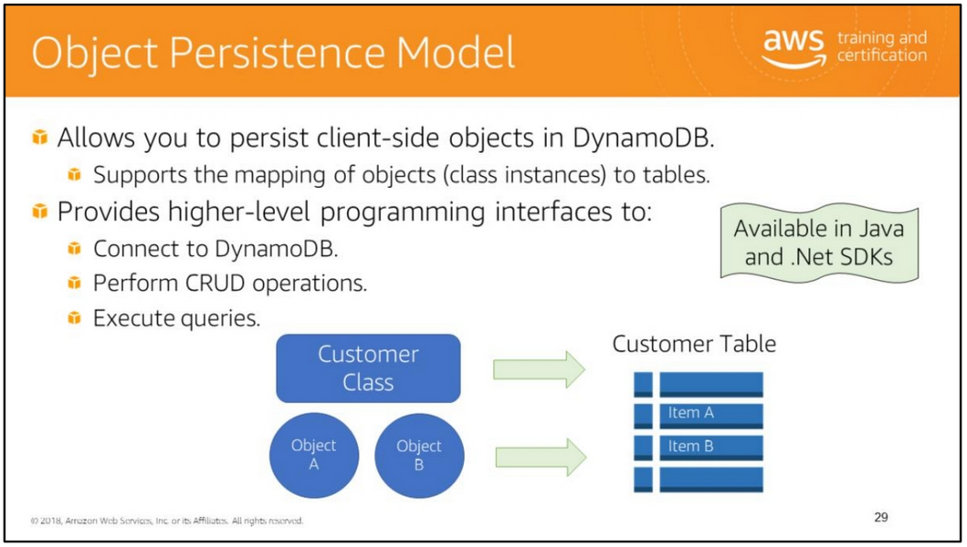
The DynamoDB object persistence model enables you to map client-side classes to DynamoDB tables. The instances of these classes (objects) map to items in a DynamoDB table.
You can use the object persistence programming interface to connect to DynamoDB, perform create, read, update, and delete operations, execute queries, and implement optimistic locking with a version number.
Support for the object persistence model is available in the Java and .Net SDKs.
For more information, see:
• Higher-Level Programming Interfaces for DynamoDB: http://docs.aws.amazon.com/amazondynamodb/latest/developerguide/ORM.html
• Optimistic Locking with Version Number (Java): http://docs.aws.amazon.com/amazondynamodb/latest/developerguide/JavaVersio nSupportHLAPI.html
• Optimistic Locking with Version Number (.NET): • https://docs.aws.amazon.com/amazondynamodb/latest/developerguide/Dynamo DBContext.VersionSupport.html

Slide 34


Slide 35
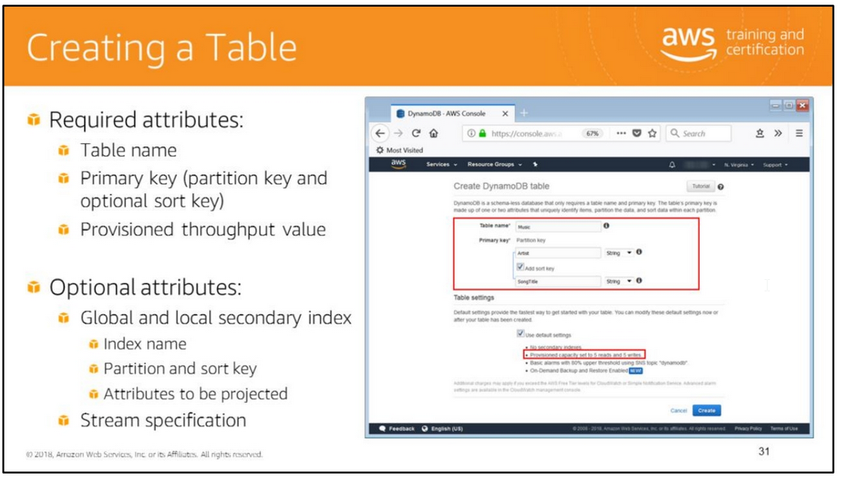
You can use the AWS Management Console for DynamoDB to create, update, and delete tables.
To create a table, specify a table name, primary key, and provisioned throughput. You can optionally specify that secondary indexes should be created and stream enabled for this table.
In an AWS account, table names must be unique within each region.
DynamoDB creates the table and sets its status to ACTIVE.
After issuing the request to create a table, wait for the table to become active before performing further operations on the table.
For more information, see http://docs.aws.amazon.com/amazondynamodb/latest/APIReference/API_CreateTabl e.html.

Slide 36
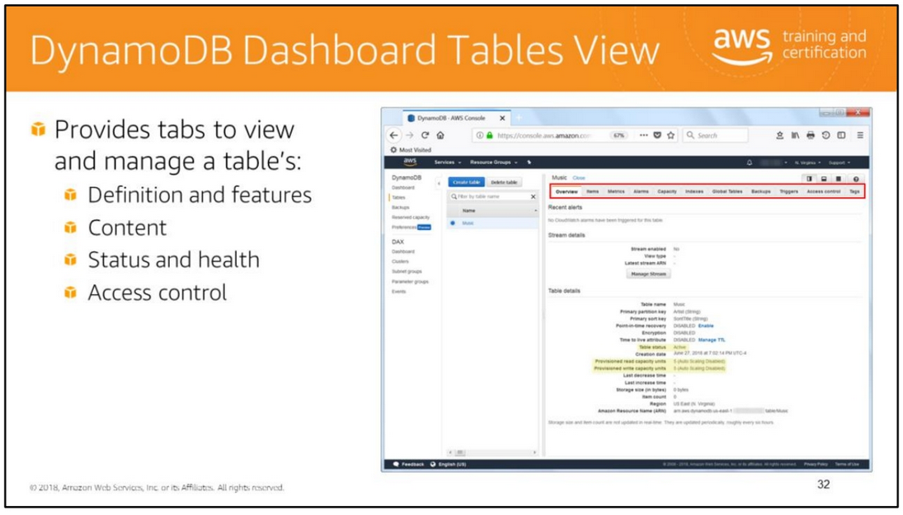
The DynamoDB console dashboard provides a Tables view where you can view and manage all aspects of a table’s definition and content. You can also use it to delete a table.
For example:
• The Overview tab displays table details including status, and provisioned read and write capacity units.
• The items tab allows you to view the items in the table.
• The Metrics tab displays performance metrics including provisioned capacity consumptions and read/write latencies.

Slide 37
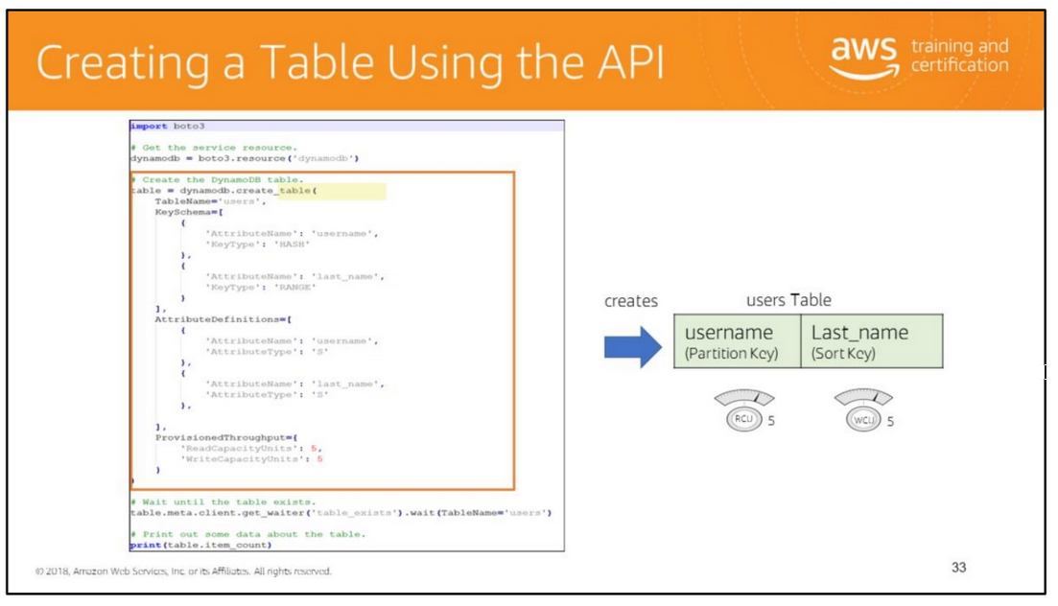
The CreateTable operation creates a new table in an asynchronous manner.
Upon receiving a CreateTable request, DynamoDB immediately returns a response with a TableStatus of CREATING.
After the table is created, DynamoDB sets the TableStatus to ACTIVE.
You can perform read and write operations only on an ACTIVE table.
You can optionally define secondary indexes on the new table, as part of the CreateTable operation.

Slide 38
The parameters for the CreateTable operation are:
• TableName: The name of the table to create.
• KeySchema: An array of attributes that make up the primary key for the table and their key type (HASH or RANGE).
The attributes in KeySchema must also be defined in the AttributeDefinitions array.
• AttributeDefinitions: An array of attributes that describe the key schema for the table and their data type.
• ProvisionedThroughput: Represents the provisioned throughput settings for the table. These settings can be modified using the UpdateTable operation.
• GlobalSecondaryIndexes: One or more global secondary indexes (the maximum is five) to be created on the table. Each global secondary index in the array includes the following:
• IndexName - The name of the global secondary index. Must be unique only for this table.
• KeySchema - Specifies the key schema for the global secondary index.
• Projection - Specifies attributes that are copied (projected) from the table into the index.
These are in addition to the primary key attributes and index key attributes, which are automatically projected.
• LocalSecondaryIndexes: One or more local secondary indexes (the maximum is five) to be created on the table. Each index is scoped to a given partition key value.
There is a 10 GB size limit per partition key value; otherwise, the size of a local secondary index is unconstrained.
Each local secondary index in the array includes the following:
• IndexName - The name of the local secondary index. Must be unique only for this table.
• KeySchema - Specifies the key schema for the local secondary index. The key schema must begin with the same partition key as the table.
• Projection - Specifies attributes that are copied (projected) from the table into the index.
These are in addition to the primary key attributes and index key attributes, which are automatically projected.
• : Represents the settings used to enable server-side encryption.
• StreamSpecifSSESpecificationication: The settings for DynamoDB Streams on the table. These settings consist of:
• StreamEnabled - Indicates whether Streams is to be enabled (true) or disabled (false).
• StreamViewType - When an item in the table is modified, StreamViewType determines what information is written to the table's stream.
Valid values for StreamViewType are:
• KEYS_ONLY - Only the key attributes of the modified item are written to the stream.
• NEW_IMAGE - The entire item, as it appears after it was modified, is written to the stream.
• OLD_IMAGE - The entire item, as it appeared before it was modified, is written to the stream.
• NEW_AND_OLD_IMAGES - Both the new and the old item images of the item are written to the stream.
This slide shows an example of how to create a table using Boto3, the AWS SDK for Python.
The invocation of the create_table method creates a table named users with a partition-and-sort primary key composed of the attributes named username and last_name (hash and range),
respectively. This method returns a DynamoDB.Table object that can be used to call additional methods on the created table.
Note that the code also shows how to wait for the table to exist before executing an action against it.
In this case, the action is to return the number of items in the table which is expected to be 0 since the table just got created.

Slide 39
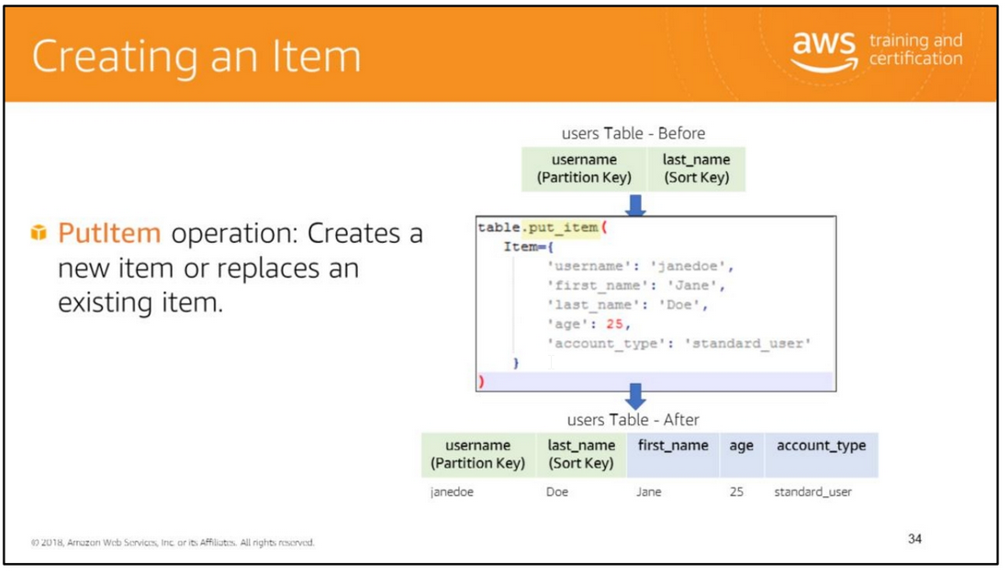

Slide 40
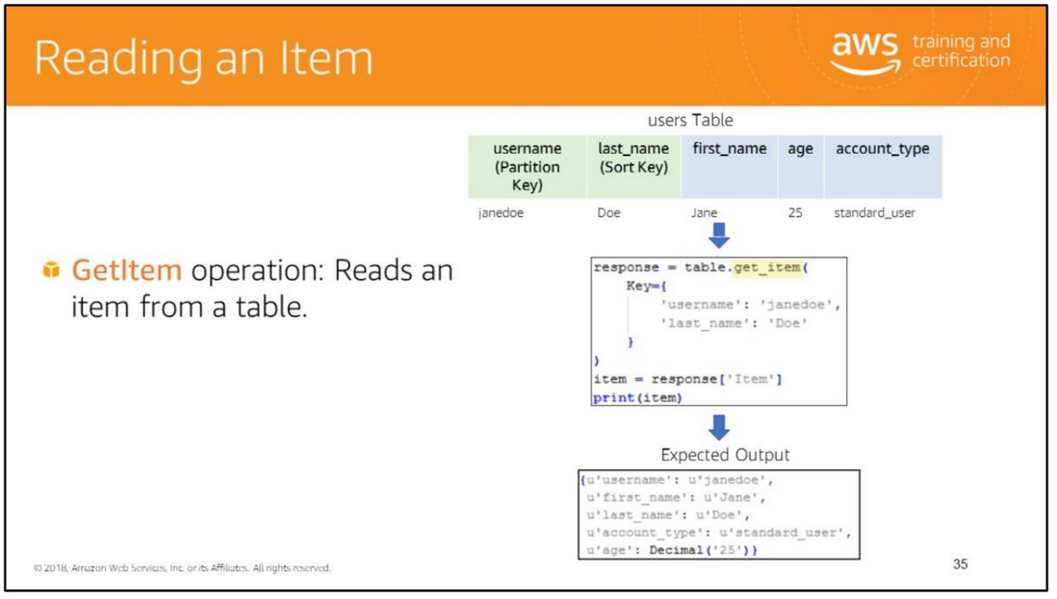

Slide 41
The PutItem operation creates a new item, or replaces an old item with a new item.
If an item that has the same primary key as the new item already exists in the specified table, the new item completely replaces the existing item.
You can perform a conditional put operation (add a new item if one with the specified primary key doesn't exist), or replace an existing item if it has certain attribute values.
You can return the item's attribute values in the same operation, using the ReturnValues parameter.
The parameters of the PutItem operation include:
• TableName: The name of the table to contain the item.
• Item: A map of attribute name/value pairs, one for each attribute.
Only the primary key attributes are required; you can optionally provide other attribute name-value pairs for the item.
• ConditionExpression: A condition that must be satisfied in order for a conditional PutItem operation to succeed.
• ReturnValues: Use ReturnValues if you want to get the item attributes as they appeared before they were updated with the PutItem request.
The valid values are:
• NONE - If ReturnValues is not specified, or if its value is NONE, then nothing is returned. This is the default value.
• ALL_OLD - If PutItem overwrote an attribute name-value pair, then the content of the old item is returned.
The example in this slide builds upon the users table scenario introduced in the discussion of the CreateTable operation.
Once the table has been created (as a DynamoDB.Table resource) and assigned to the table variable, the DynamoDB.Table.put_item() method is invoked to add a new item to the table.
For more information see https://docs.aws.amazon.com/amazondynamodb/latest/APIReference/API_PutItem.html
The example in this slide retrieves an item in the users table using the DynamoDB.Table.get_item() method in the AWS SDK for Python and prints it to standard output.
The expected result is a JSON object containing all of the attributes of the item. For more information, see:
• http://docs.aws.amazon.com/amazondynamodb/latest/developerguide/Working WithItems.html#WorkingWithItems.ReadingData
• http://docs.aws.amazon.com/amazondynamodb/latest/APIReference/API_GetIte m.html

Slide 42
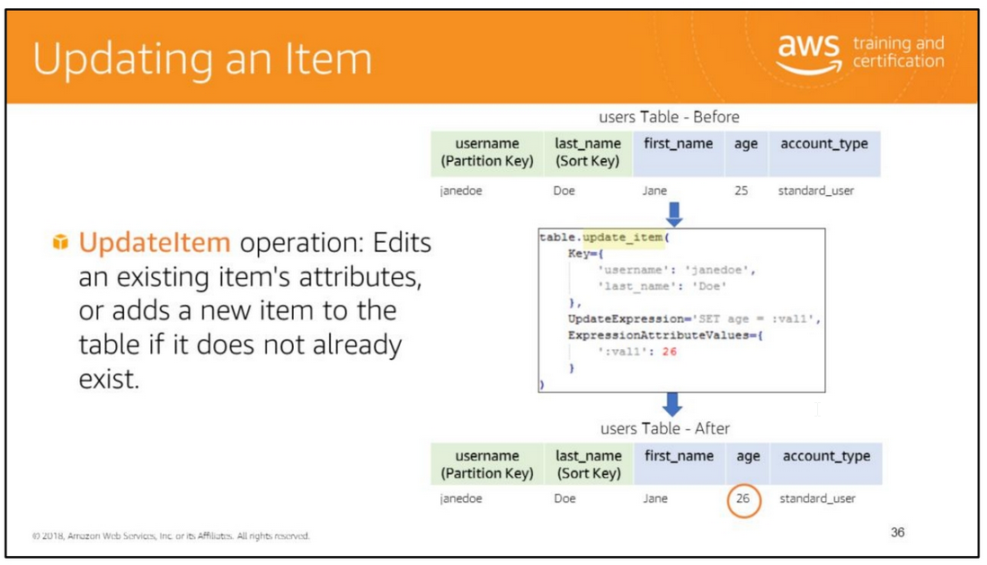
The UpdateItem operation allows to update an existing item's attributes, or add a new item to the table if it does not already exist. You add, set, or remove attribute values.
You can also perform a conditional update on an existing item (for example, replace an existing name-value pair if it has certain expected attribute values).
Additionally, you can return the item's attribute values, before or after the update, by using the ReturnValues parameter.
The parameters of the UpdateItem operation include:
• TableName: The name of the table containing the item to update.
• Key: A map of attribute name/value pairs representing the primary key of the item to update.
• UpdateExpression: An expression that defines one or more attributes to be updated, the action to be performed on them, and new value(s) for them.
The action values are available are: SET, REMOVE, ADD and DELETE.
• ExpressionAttributeValues: One or more values that can be substituted in an expression.
• ReturnValues: Use ReturnValues if you want to get the item attributes as they appear before or after they are updated.
In the Python example above, the DynamoDB.Table.update_item() method is used to modify the age attribute of an item in the users table.
For more information, see https://docs.aws.amazon.com/amazondynamodb/latest/APIReference/API_UpdateIt em.html.

Slide 43
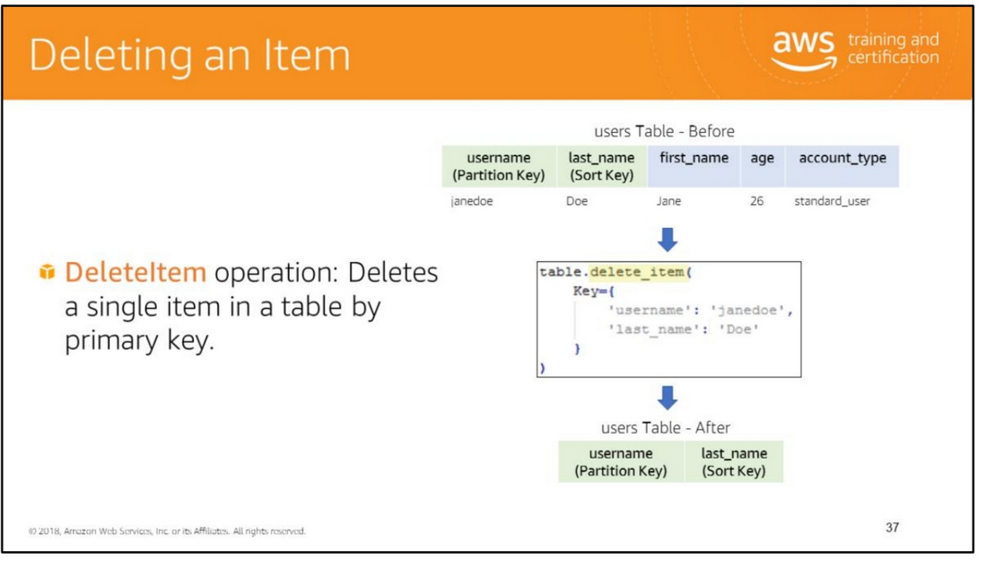
The DeleteItem operation allows you to delete an item in a table using its primary key. You can perform a conditional delete operation that deletes the item if it has an expected attribute value.
In addition to deleting an item, you can also return the item's attribute values by using the ReturnValues parameter.
The parameters of the DeleteItem operation include:
• TableName: The name of the table containing the item to delete.
• Key: A map of attribute name/value pairs representing the primary key of the item to delete.
• ConditionExpression: A condition that must be satisfied in order for a conditional DeleteItem operation to succeed.
• ReturnValues: Use ReturnValues if you want to get the item attributes as they appeared before they were deleted.
The valid values are: NONE, ALL_OLD, UPDATED_OLD, ALL_NEW and UPDATED_NEW
The example in this slide shows how to user the Python DynamoDB.Table.delete_item() method to delete an item from the users table. For more information see © 2018 Amazon Web Se
http://docs.aws.amazon.com/amazondynamodb/latest/APIReference/API_DeleteItem.html.

Slide 44
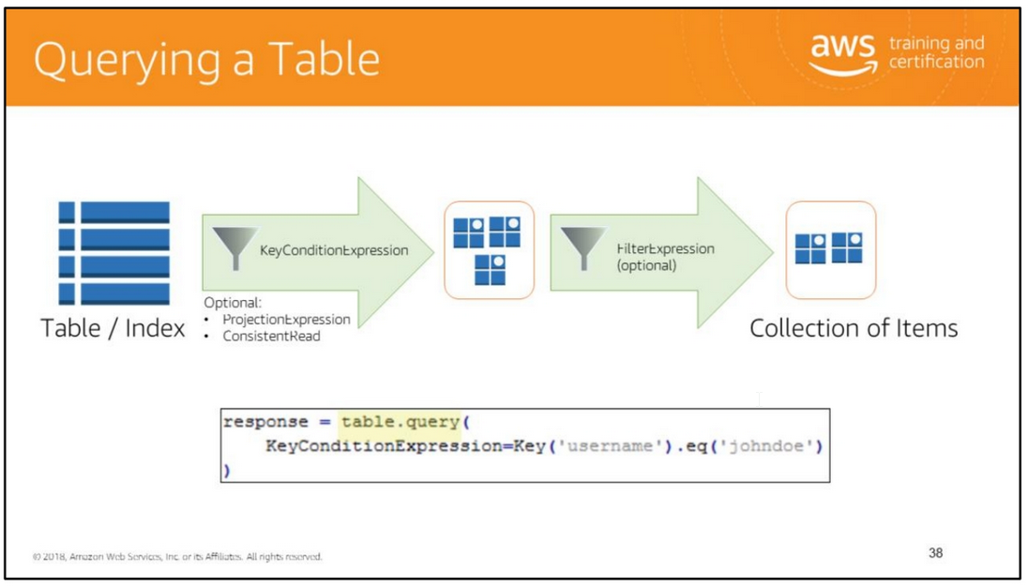
The Query operation reads from a table or secondary index only the items that match the primary key specified in the key condition expression.
It then refines the result set further based on the filter expression, if specified. You must explicitly specify the name of the table or secondary index that you wish to query.
The Query operation returns a result set with the items that match the conditions specified or returns an empty result set if none of the items satisfy the given criteria.
The parameters of the Query operation include:
• TableName: The name of the table containing the items to query.
• KeyConditionExpression: The condition that specifies the key value(s) for items to be retrieved by the Query action.
Y ou must provide the partition key as an equality condition. You can optionally provide a condition on the sort key.
• ProjectionExpression: A string that identifies one or more attributes to retrieve from the table.
The attributes in the expression must be separated by commas. If no attribute names are specified, then all attributes will be returned.
If any of the requested attributes are not found, they will not appear in the result.
• ConsistentRead: Determines the read consistency model. If set to true, then the operation uses strongly consistent reads; otherwise, the operation uses eventually consistent reads.
• FilterExpression: A string that contains conditions that DynamoDB applies after the Query operation, but before the data is returned to you.
Items that do not satisfy the FilterExpression criteria are not returned. A FilterExpression does not allow key attributes.
You cannot define a filter expression based on a partition key or a sort key.
The Python code example shown in this slide uses the DynamoDB.Table.query() method to retrieve all the items in the users table
that have a primary key value equal to “johndoe”.
For more information, see: • https://docs.aws.amazon.com/amazondynamodb/latest/developerguide/Query.ht ml • http://docs.aws.amazon.com/amazondynamodb/latest/APIReference/API_Query.h tml

Slide 45
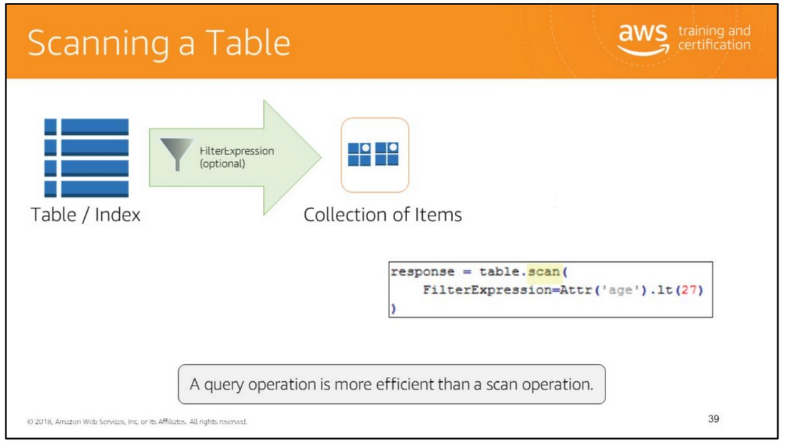
The Scan operation is similar to a Query operation except that the Scan operation reads all items from the table or index.
The result set can be refined using a filter expression. The parameters of the Scan operation include:
• TableName: The name of the table containing the items to scan.
• ProjectionExpression: A string that identifies one or more attributes to retrieve from the table.
The attributes in the expression must be separated by commas. If no attribute names are specified, then all attributes will be returned.
If any of the requested attributes are not found, they will not appear in the result.
• ConsistentRead: Determines the read consistency model. If set to true, then the operation uses strongly consistent reads; otherwise, the operation uses eventually consistent reads.
• FilterExpression: A string that contains conditions that DynamoDB applies after the Scan operation, but before the data is returned to you.
Items that do not satisfy the FilterExpression criteria are not returned.
The Python code example shown in this slide uses the DynamoDB.Table.scan() method to retrieve all the users whose age is less than 27.
Because the scan operation reads all items from the table or index, it is an expensive operation.
It is more efficient to perform a query operation with the appropriate key condition expression to return only the data that your application really needs.
If you must do a scan, perform a parallel scan when possible.
For more information, see:
• https://docs.aws.amazon.com/amazondynamodb/latest/developerguide/Scan.htm l
• https://docs.aws.amazon.com/amazondynamodb/latest/developerguide/Scan.htm l#Scan.ParallelScan
• http://docs.aws.amazon.com/amazondynamodb/latest/APIReference/API_Scan.html

Slide 46
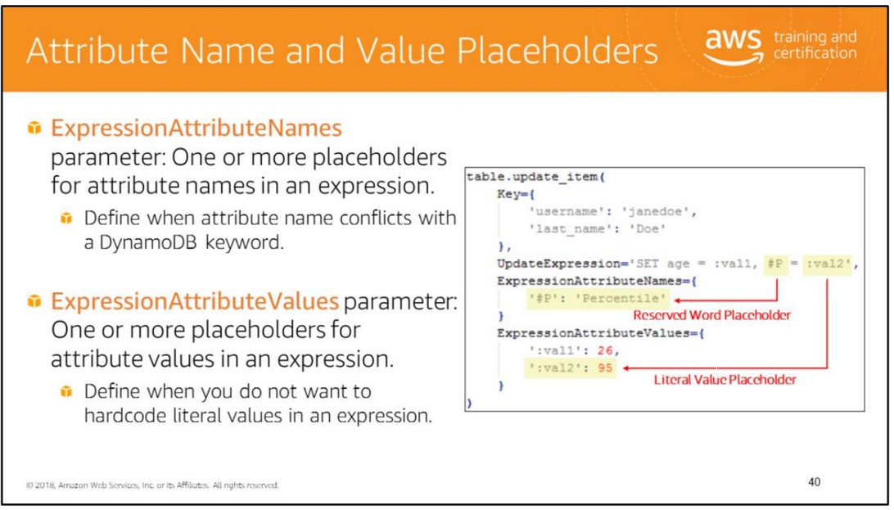
An expression attribute name is a placeholder that you use in an expression, as an alternative to the actual attribute name.
An expression attribute name must begin with a number sign (#), followed by one alphabetic character, and then by zero or more alphanumeric characters.
You might use an expression attribute name when your attribute name conflicts with a DynamoDB reserved word (such as BACKUP).
For more information about DynamoDB reserved words, see http://docs.aws.amazon.com/amazondynamodb/latest/developerguide/ReservedWords.html.
Expression attribute values are substitutes for the actual values that you want to compare (values that you might not know until runtime).
An expression attribute value must begin with a colon (:), followed by one alphabetic character, and then by zero or more alphanumeric characters.

Slide 47
You can use expression attribute name and value placeholders in all types of expressions such as key condition expressions, filter expressions, and projection expressions.
In the Python code example shown in this slide:
• The #P name is a placeholder for an attribute named Percentile which cannot be used in an expression because it is a DynamoDB reserved word.
• The :val2 name is a place holder for the literal value of 95.
For more information, see:
• https://docs.aws.amazon.com/amazondynamodb/latest/developerguide/Expressi ons.ExpressionAttributeNames.html
• https://docs.aws.amazon.com/amazondynamodb/latest/developerguide/Expressi ons.ExpressionAttributeValues.html

Slide 48
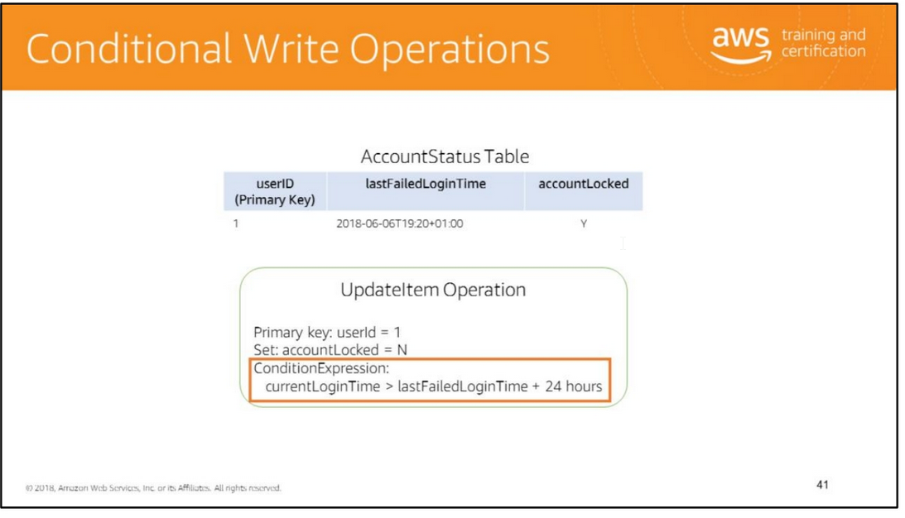
ConditionExpression parameter: A condition that must be satisfied in order for a write operation to be performed.
Just like you specify conditions when querying information from a table, you can specify that a write operation should be performed only if a given condition is true.
In the example shown, the accountLocked attribute in the AccountStatus table can be set to N only if the last failed login attempt was more than 24 hours earlier.
You can make comparisons with comparison operators, use logical operators, and use functions to check for the existence and values of specific attributes.
For more information about performing conditional writes, see https://docs.aws.amazon.com/amazondynamodb/latest/developerguide/Expression .ConditionExpressions.html.

Slide 49
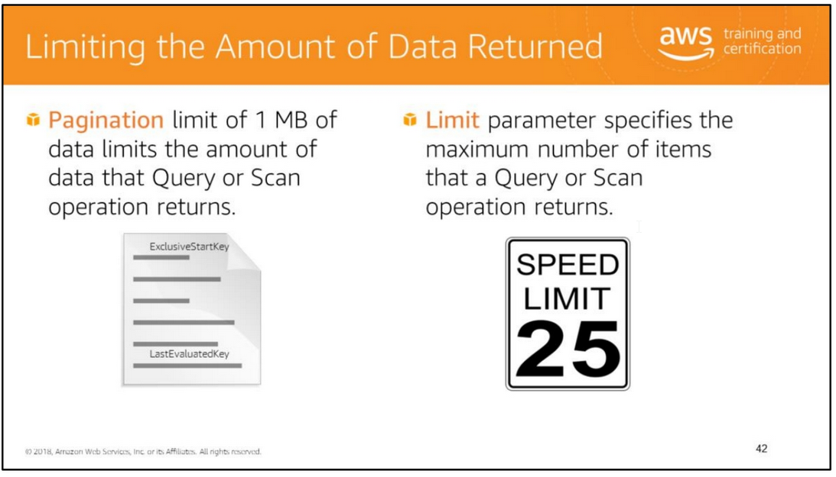
The number of items returned by a Query or Scan operation is affected by two factors:
• The default pagination limit of 1 MB of data
• The value of the Limit parameter DynamoDB paginates results returned by Query and Scan operations.
The results are divided into "pages" of data that are 1 MB in size (or less).
An application can process the first page of results, then the second page, and so on.
A single Query will only return a result set that fits within the 1 MB size limit.
The Query and Scan operations also allows you to limit the number of items that are returned in the result.
To do this, set the Limit parameter to the maximum number of items that you want.
Together both factors affect the number of items returned as follows:
• If DynamoDB reaches Limit parameter value while processing the results, it stops the operation and returns
the matching values up to that point, and a key in LastEvaluatedKey parameter to apply in a subsequent operation.
This allows you to pick up where you left off.
Also, if the processed data set size exceeds 1 MB before DynamoDB reaches this limit, it stops the operation and returns the
matching values up to the limit, and a key in the LastEvaluatedKey parameter.
• DynamoDB returns a LastEvaluatedKey value if the operation did not return all the matching items in the table.
To retrieve all matching items from a table, use the LastEvaluatedKey value from the previous request
as the ExclusiveStartKey value in the next request. Repeat this until the LastEvaluatedKey value is null.
A null value implies that no more results exist.
For more information, see:
• https://docs.aws.amazon.com/amazondynamodb/latest/developerguide/Query.ht ml#Query.Limit
• https://docs.aws.amazon.com/amazondynamodb/latest/developerguide/Query.ht ml#Query.Pagination

Slide 50
The number of items returned by a Query or Scan operation is affected by two factors:
• The default pagination limit of 1 MB of data
• The value of the Limit parameter DynamoDB paginates results returned by Query and Scan operations.
The results are divided into "pages" of data that are 1 MB in size (or less).
An application can process the first page of results, then the second page, and so on.
A single Query will only return a result set that fits within the 1 MB size limit.
The Query and Scan operations also allows you to limit the number of items that are returned in the result.
To do this, set the Limit parameter to the maximum number of items that you want.
Together both factors affect the number of items returned as follows:
• If DynamoDB reaches Limit parameter value while processing the results, it stops the operation and returns
the matching values up to that point, and a key in LastEvaluatedKey parameter to apply in a subsequent operation.
This allows you to pick up where you left off.
Also, if the processed data set size exceeds 1 MB before DynamoDB reaches this limit, it stops the operation and returns the
matching values up to the limit, and a key in the LastEvaluatedKey parameter.
• DynamoDB returns a LastEvaluatedKey value if the operation did not return all the matching items in the table.
To retrieve all matching items from a table, use the LastEvaluatedKey value from the previous request
as the ExclusiveStartKey value in the next request. Repeat this until the LastEvaluatedKey value is null.
A null value implies that no more results exist.
For more information, see:
• https://docs.aws.amazon.com/amazondynamodb/latest/developerguide/Query.ht ml#Query.Limit
• https://docs.aws.amazon.com/amazondynamodb/latest/developerguide/Query.ht ml#Query.Pagination

Slide 51
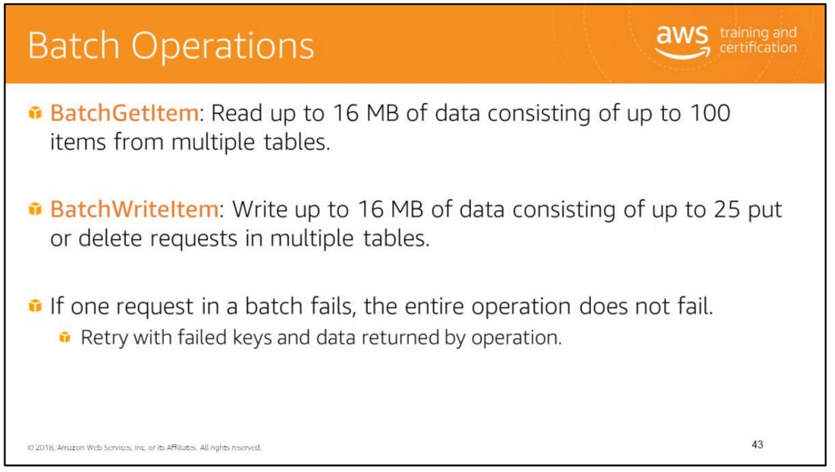
You can retrieve or write data to DynamoDB in batches.
Advantages:
• Achieve higher throughput by writing, deleting, or replacing multiple items in a single request.
• Take advantage of parallelism without having to manage multiple threads on your own.
Achieve lower average latencies, compared to using single PutItem or DeleteItem operations,
when writing, deleting, or replacing multiple items.
For more information, see:
• Working with Items:
http://docs.aws.amazon.com/amazondynamodb/latest/developerguide/Working WithItems.html#WorkingWithItems.BatchOperations
• http://docs.aws.amazon.com/amazondynamodb/latest/APIReference/API_BatchG etItem.html
• http://docs.aws.amazon.com/amazondynamodb/latest/APIReference/API_BatchW riteItem.html

Slide 52


Slide 53
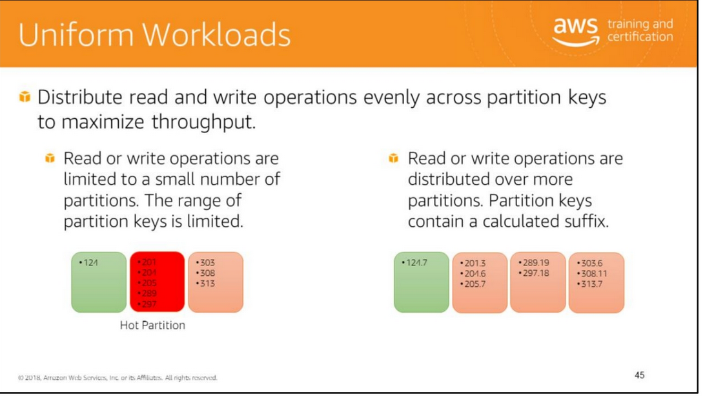
The partition key determines the distribution of data across the partitions where data is stored. The total throughput provisioned for a table is divided equally across partitions.
When you make a large number of consecutive reads or consecutive writes to a narrow range of partition keys, the same partitions are accessed repeatedly (hot partitions).
The throughput allocated to remaining partitions remains unused.
To achieve maximum read and write throughput, implement your read and write operations as follows:
• Choose the partition key carefully to avoid hot spots.
• Consider concatenating a random number or a calculated value to the partition key when writing data to ensure distribution of partition keys.
For example, you might concatenate the sum of the ASCII values of each character in the partition key.
• Distribute reads and writes across multiple partitions.

Slide 54
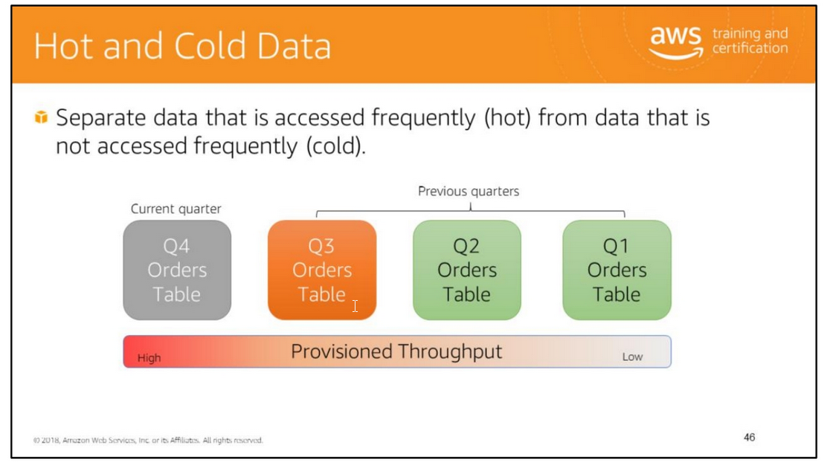
Consider access patterns for your data. For example, you might have an Orders table with a partition key of customer id and sort key of timestamp.
Your application probably accesses the latest order data most of the time. It might rarely access data about very old orders.
In such cases, consider breaking the time series data into separate tables.
Store the frequently accessed “hot” data in a separate table with higher throughput.
Store rarely accessed “cold” data in tables with lower throughput.
You can even move the old data to other storage options such as an Amazon S3 bucket and delete the table that contains the old data.

Slide 55
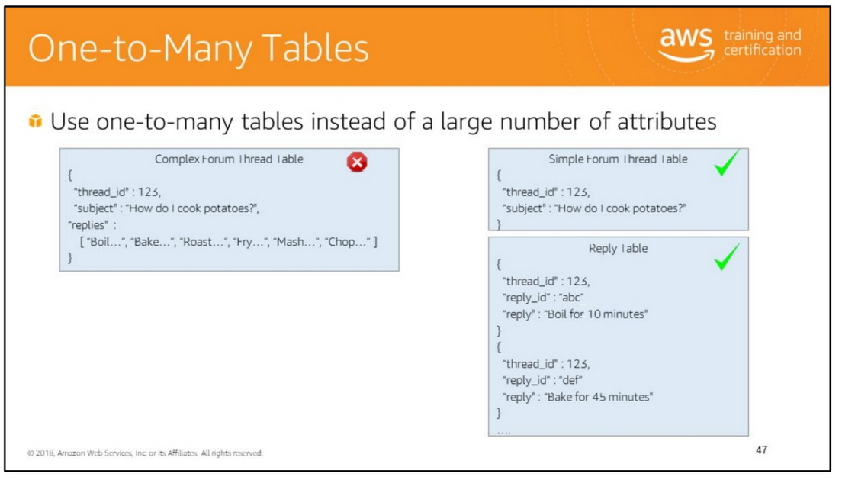
If your table has items that store a large number of values in an attribute of set type, such as string set or number set, consider removing the set attribute from the table and splitting it
as separate items in another table.
For example, if you have a table that stores threads in a forum and replies as a string set in each item, each item be very large.
The item size is likely to exceed the maximum item size in Dynamo DB.
Throughput will be reduced because you will unnecessarily fetch large amounts of data even if you only need minimum information such as the thread subject.
Remove the replies from the forum thread table. Create a separate table to store the replies as individual items

Slide 56
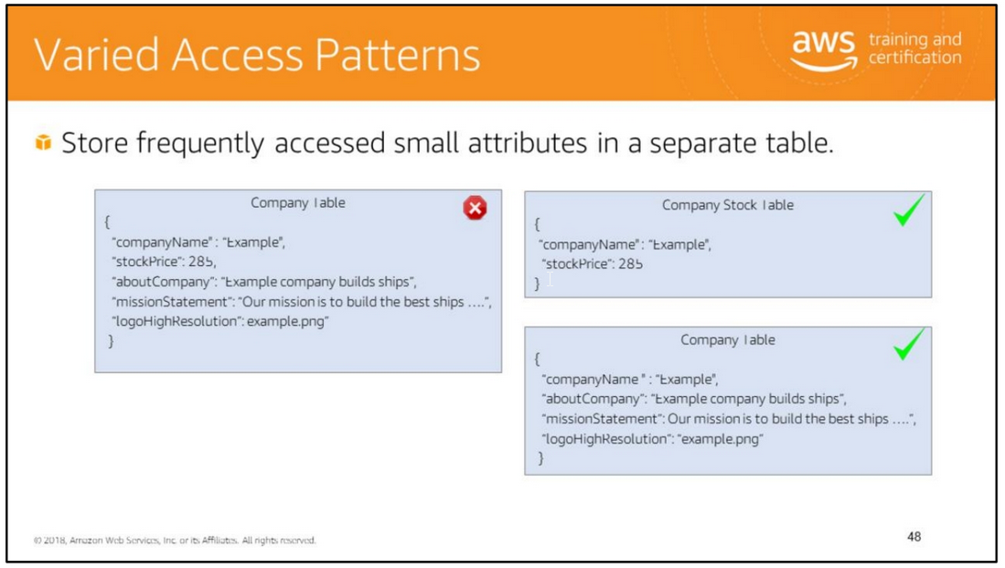
If you frequently access large items in a table but do not use the large attribute values, consider storing frequently accessed smaller attributes in a separate table.
For example, consider the Company table. It has fairly large attributes such as company information, mission statement, and logo. These attributes are fairly static and rarely accessed.
To improve throughput, consider splitting the frequently changing and frequently read stock price attribute to a separate table.

Slide 57
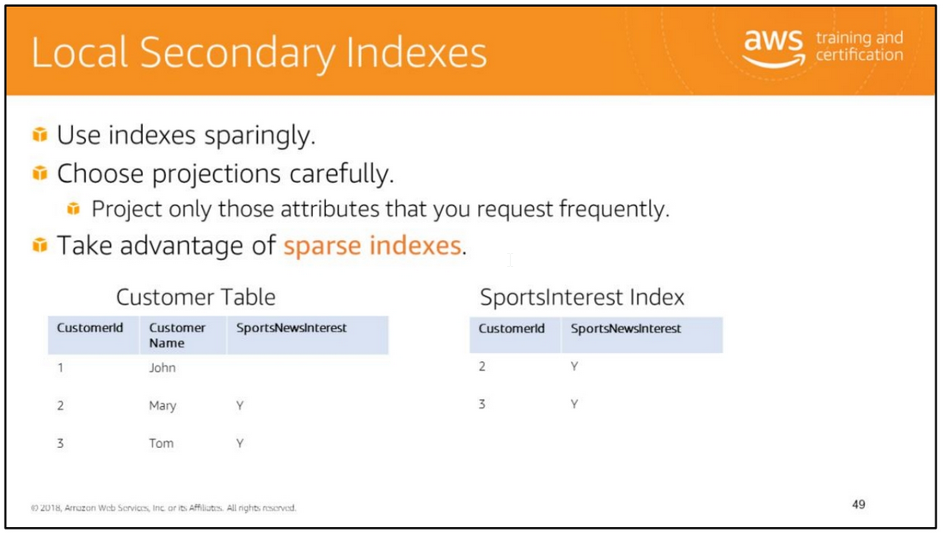
Local secondary indexes consume storage and the table's provisioned throughput. Keep the size of the index as small as possible.
Create local secondary indexes only on attributes that you query often.
For any item in a table, DynamoDB will only write a corresponding entry in the index, if the index's sort key attribute is present in the item.
For example, consider the Customer table (the partition key is CustomerID) and SportsInterest index (the partition key is Customer id, and the sort key is SportsNewsInterest).
DynamoDB will add an entry to the SportsNewsInterest index only if the original item contains a value for the SportsNewsInterest attribute.
Therefore, the index is said to be sparse because it does not contain an entry for every item in the table.
You can use the sparse index to easily retrieve information about customers who are interested in sports news.
For more information about local secondary indexes, see https://docs.aws.amazon.com/amazondynamodb/latest/developerguide/bp-indexes-general.html.

Slide 58
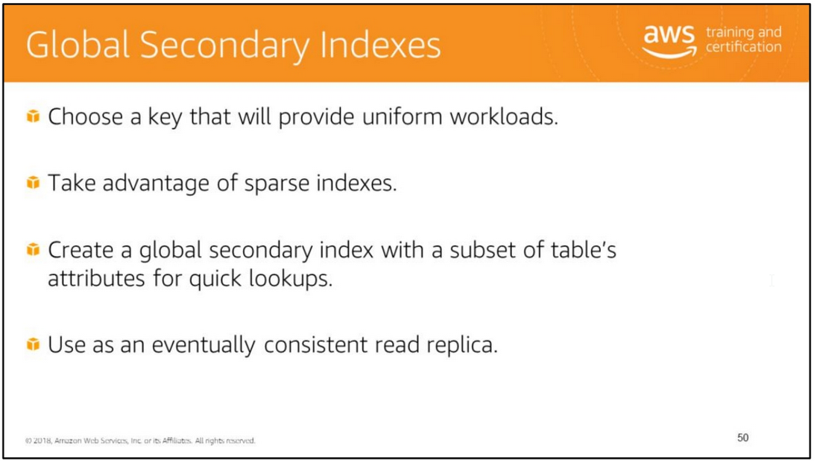

Slide 59
The importance of uniform workloads in the context of DynamoDB tables was discussed. The same considerations apply to global secondary indexes.
Choose a partition key and sort key that will distribute reads across multiple partitions.
DynamoDB will only write a corresponding entry to a global secondary index if the index key value is present in the item.
herefore, the index may be sparse because it does not contain all items that are in the parent table. You can use these sparse indexes for efficient queries.
You can create a global secondary index with the same key schema as the table but with a subset of the table’s attributes.
You can then provision minimal throughput for this index and use it for lookups of data. Consider the following scenarios:
• You want to restrict read access to a table that contains sensitive data.
• You have a high priority application that should read strongly consistent data with high throughput. You have a low priority application that does not need the latest data.
To handle such scenarios, you can create a global secondary index that has lower provisioned throughput and has a subset of the table’s attributes.
The high priority application can perform strongly consistent reads with high throughput from the table.
The low priority application can perform eventually consistent reads from the global secondary index with lower throughput.
This approach ensures that the required throughput is always available for the high priority application.
The global secondary index functions as an eventually consistent read replica.
For more information, see https://docs.aws.amazon.com/amazondynamodb/latest/developerguide/bp-indexes-general.html.

Slide 60
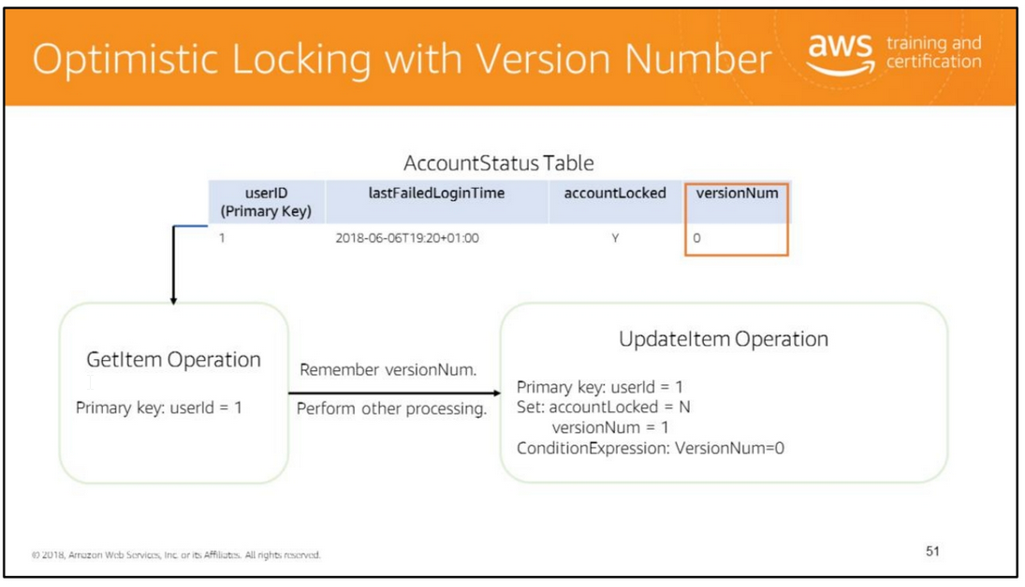
Use optimistic locking with a version number as described below to make sure that an item has not changed since the last time you read it.
Maintain a version number to check that the item has not been updated between the last read and update.
Consider a scenario where you read an item from the AccountStatus table and do some processing.
Then you set the accountLocked attribute to N because you determined that the last failed login was over 24 hours earlier.
It is possible that the user may have made another failed login attempt between the time that you read the data and when you made the update.
The update is incorrect because it is based on stale information. The optimistic locking approach solves this problem:
Read the item and remember the version number (versionNum = 0).
2. Make the state transition in memory after validating information (accountLocked = N if currentLoginTime > lastFailedLoginTime + 24 hours).
3. Increment the version number (versionNum = 1).
4. Write the item with updated attributes (accountLocked = N and versionNum = 1). Use a conditional expression to perform a write only if the item has not changed since it was last read
5. If the condition fails, start over from step 1.
This approach is also known as the read-modify-write design pattern or optimistic concurrency control.

Slide 61
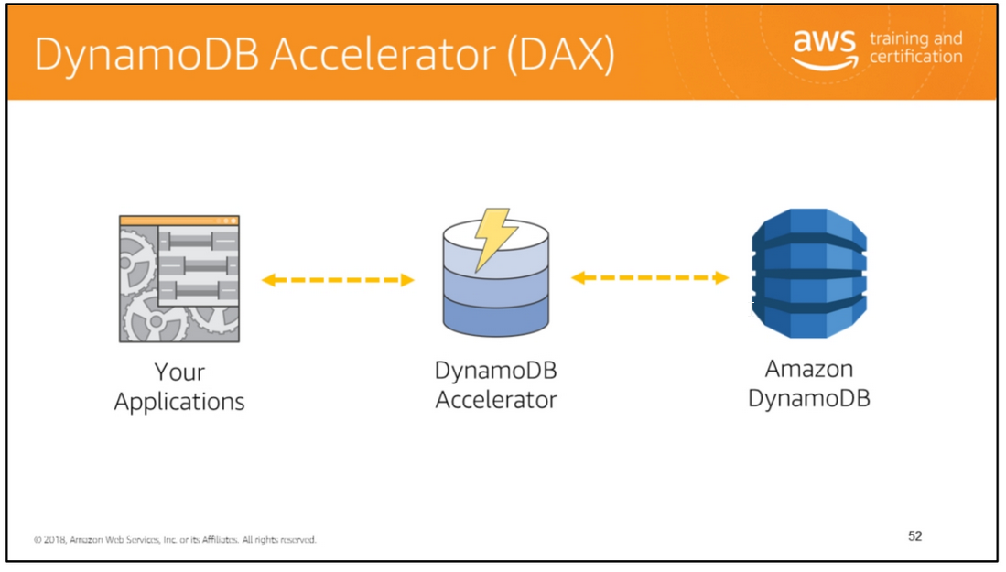

Slide 62
Add in-memory acceleration to DynamoDB tables. Amazon DynamoDB is designed for scale and performance.
In most cases, the DynamoDB response times can be measured in single-digit milliseconds.
However, there are certain use cases that require response times in microseconds.
For these use cases, DynamoDB Accelerator (DAX) delivers fast response times for accessing eventually consistent data.
DAX is a DynamoDB-compatible caching service that enables you to benefit from fast in-memory performance
for demanding applications. DAX addresses three core scenarios:
As an in-memory cache, DAX reduces the response times of eventually-consistent read workloads by an order
of magnitude, from single-digit milliseconds to microseconds.
2. DAX reduces operational and application complexity by providing a managed service that is API-compatible
with Amazon DynamoDB, and thus requires only minimal functional changes to use with an existing application.
3. For read-heavy or bursty workloads, DAX provides increased throughput and potential operational cost savings
by reducing the need to over-provision read capacity units.
This is especially beneficial for applications that require repeated reads for individual keys.
DAX is a read-through/write-through cache.
When a read is issued to DAX it will first check to see if that item is in cache.
If it is, DAX returns the value with response times in microseconds.
If the item is not in cache, DAX automatically fetches the item from DynamoDB, caches the result for subsequent reads,
and returns the value to the application.
For writes, DAX first writes the value to DynamoDB, caches the value in DAX, and then returns success to the application.

Slide 63


Slide 64

For more information about troubleshooting, see:
• Error Handling: https://docs.aws.amazon.com/amazondynamodb/latest/developerguide/Program ming.Errors.html#APIError
• Monitoring DynamoDB with CloudWatch: http://docs.aws.amazon.com/amazondynamodb/latest/developerguide/Monitorin gDynamoDB.html
• Logging DynamoDB API Operations by Using AWS CloudTrail: http://docs.aws.amazon.com/amazondynamodb/latest/developerguide/logging-using-cloudtrail.html

Slide 65

Handle error codes in exceptions gracefully to ensure a smooth customer experience.
For more information about handling DynamoDB errors, see
http://docs.aws.amazon.com/amazondynamodb/latest/developerguide/ErrorHandling.html.

Slide 66


Slide 67

Batch operations can read or write items from one or more tables. Individual requests in a batch operation may fail.
The most likely reason for failure is that the table in question does not have enough provisioned read or write capacity.
Use the information about failed tables and items to retry the batch operation with exponential backoff.
For more information, see:
• http://docs.aws.amazon.com/amazondynamodb/latest/APIReference/API_BatchG etItem.html
• http://docs.aws.amazon.com/amazondynamodb/latest/APIReference/API_BatchW riteItem.html

Slide 68

As discussed in previous sections, ensure that you have provisioned adequate throughput as needed for the application’s workload.
Follow the best practices discussed to create appropriate indexes and write efficient queries.
You can set up CloudWatch alarms to notify you when request rates for a table exceed a certain threshold of the provisioned throughput.
For example, you might set up a CloudWatch alarm to notify you when request rates exceed a level that is 80% of the table’s provisioned throughput.
If your application has a sudden surge in requests, you can respond to the CloudWatch alarm by provisioning additional throughput.
You can also set up an AWS Lambda function to be triggered based on a CloudWatch alarm.
The Lambda function can update the table to provision additional throughput.
For more information about what metrics are available, see http://docs.aws.amazon.com/AmazonCloudWatch/latest/monitoring/dynamo-metricscollected.html.

Slide 69


Slide 70



Slide 71


Slide 72

Read left to right:
(False) Amazon DynamoDB is a fast and flexible NoSQL database service for applications.
(True)
(True)
(False) RCU is the number of strongly consistent reads per second of items up to 4 KB in size.
(True) To achieve maximum read and write throughput, choose the partition key carefully to avoid hot spots.
(False) Any changes made to any item in any replica table will be replicated to all of the other replicas within the same global table.

Slide 74



You will learn how to use the AWS SDK to create Amazon DynamoDB tables and indexes,
add and update items, and query data. In the lab, will use the AWS SDK to:
• Create a DynamoDB table and global secondary index.
• Add and updates items in a table.
• Query a global secondary index.
You will develop an application that retrieves the infections data CSV file from an S3 bucket and loads
the data into a DynamoDB table. You will create and use any necessary secondary indexes to query
the data and print a count of infections for a particular city.
Finally, you will link to S3 objects from the DynamoDB data.

Slide 75


Slide 76


Slide 77

You should consider your application's requirements when you determine which type of index to use.
This table shows the main differences between a global secondary index and a local secondary index.

Slide 78

This table summarizes the main features of the database options offered by AWS.

Slide 79

This table summarizes the key usage scenarios for the different database services offered by AWS.

Slide 80

Familiarize yourself with the DynamoDB related API in the SDK for your preferred language.
Java
• Index page: http://docs.aws.amazon.com/AWSJavaSDK/latest/javadoc/
• AmazonDynamoDBClient: http://docs.aws.amazon.com/AWSJavaSDK/latest/javadoc/com/amazonaws/servic es/dynamodbv2/AmazonDynamoDBClient.html
• DynamoDB class: http://docs.aws.amazon.com/AWSJavaSDK/latest/javadoc/com/amazonaws/servic es/dynamodbv2/document/DynamoDB.html
• Create a table:
https://docs.aws.amazon.com/AWSJavaSDK/latest/javadoc/com/amazonaws/servi ces/dynamodbv2/document/DynamoDB.html#createTable-
com.amazonaws.services.dynamodbv2.model.CreateTableRequest-
NET
• Index page: http://docs.aws.amazon.com/sdkfornet/v3/apidocs/Index.html
• AmazonDynamoDBClient: https://docs.aws.amazon.com/sdkfornet/v3/apidocs/items/DynamoDBv2/TDynam oDBClient.html
• Create a table:
https://docs.aws.amazon.com/sdkfornet/v3/apidocs/items/DynamoDBv2/MDyna moDBCreateTableStringList!KeySchemaElement!List!AttributeDefinition!Provisione dThroughput.html
Python
• Index page: http://boto3.readthedocs.org/en/latest/reference/core/index.html
• DynamoDB resource: http://boto3.readthedocs.org/en/latest/reference/services/dynamodb.html#servi ce-resource
• Create a table:
http://boto3.readthedocs.org/en/latest/reference/services/dynamodb.html#Dyna moDB.ServiceResource.create_table

